Slide 1
Breathing New life into downtown
South Milwaukee Development update
November, 2014
Notes:
Could talk about …
New developments like Dunkin’ Donuts, Burger King and Planet Fitness coming to town ...
Or the story with our TIFs … three development districts that present some unique opportunities for developers throughout the city
Or the development opportunity around the former AMF South Park Lanes site … 7 acres located just blocks from Grant Park.
Or how the city is just finalizing the purchase now of more than 2 acres of terrific real estate right about our Mill Pond
Or …
But I want to tell a story near and dear to my heart today. The story about the rebirth of downtown South Milwaukee … a story that, while off to a great start, in many ways is still being written.

Slide 2
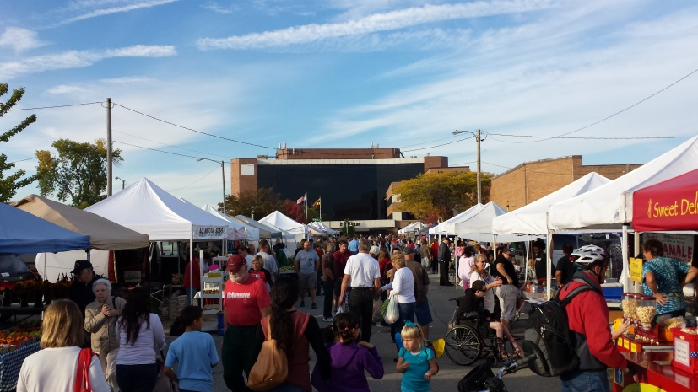
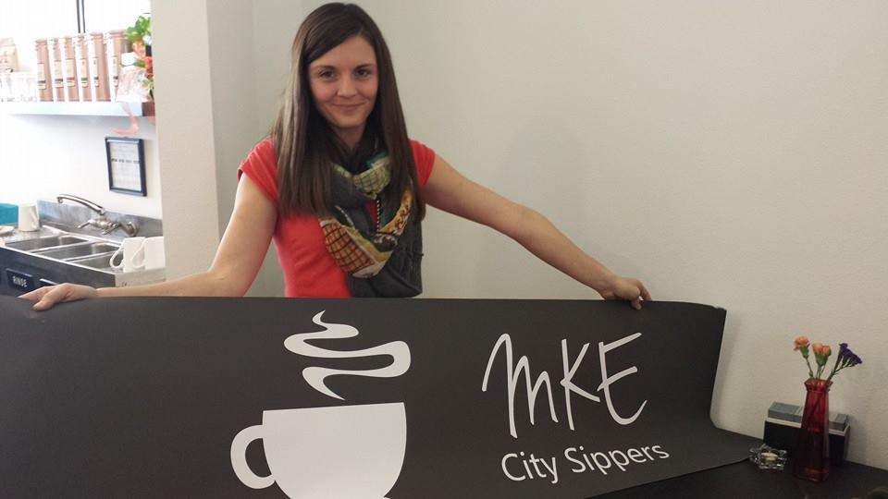
DOWNTOWN MOMENTUM
BUSINESS INVESTMENT
NEW BUSINESS
FARMERS’ MARKET
BUSINESS-BUILDING EVENTS
BIG PLANS FOR 2015
Notes:
It’s already a great story, and we’re just getting started, one built around …

Slide 3
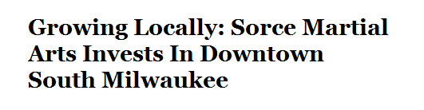
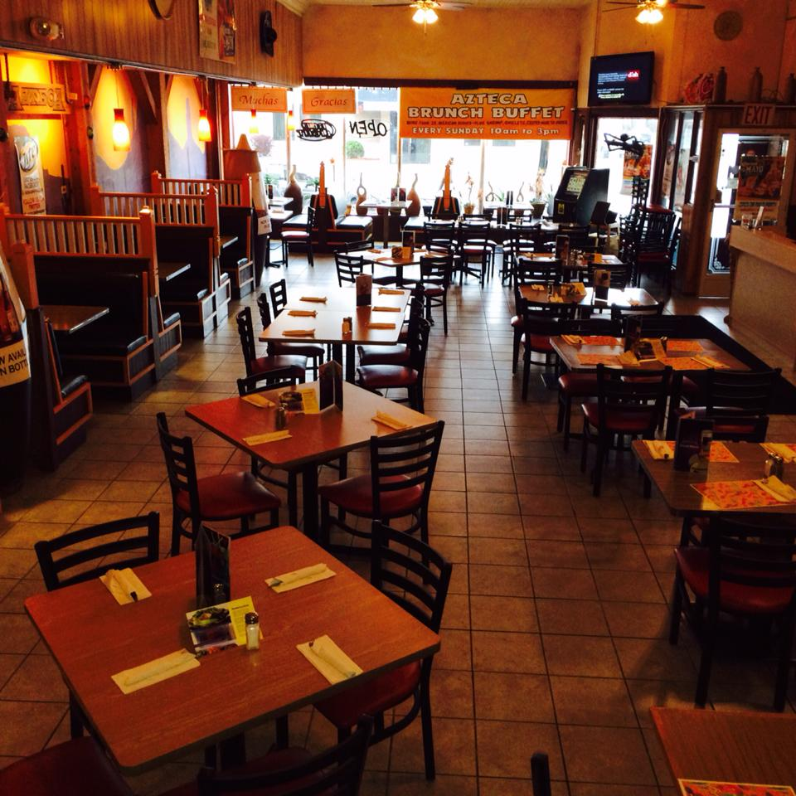

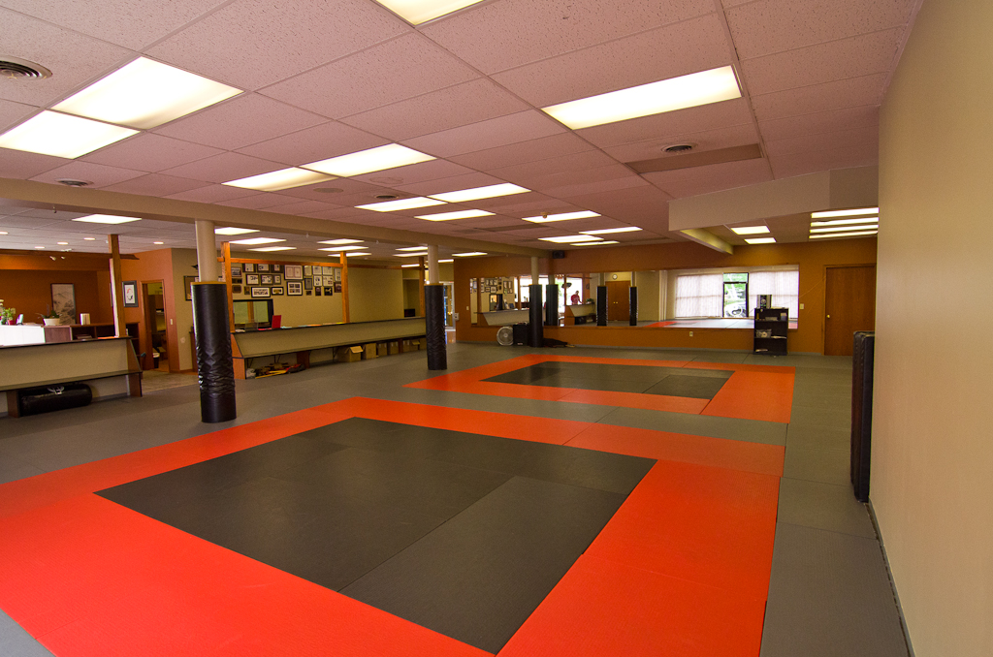
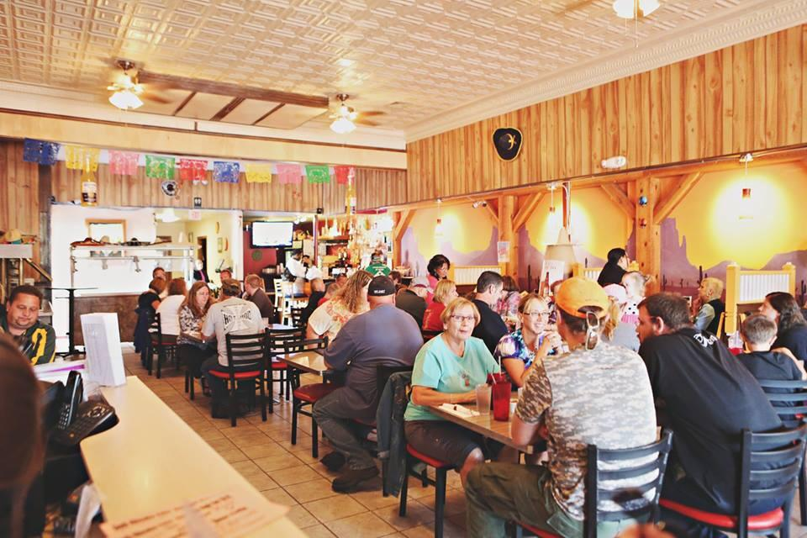
investment
Notes:
It’s a story of investment, with some our most successful local businesses getting on board.
Major remodels
Azteca Restaurant
Sorce Martial Arts
And we’re being proactive on property maintenance … working firmly with property owners to fix up their buildings at least to code … and hopefully beyond … so you’re starting to see new windows here, new coats of paint there with some of our more troubled properties

Slide 4
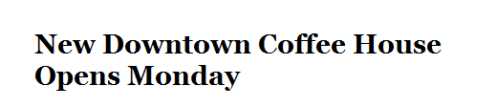
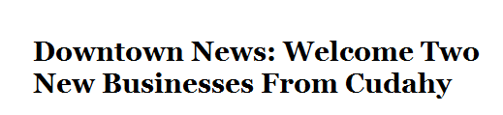
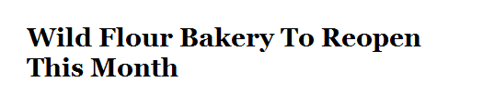
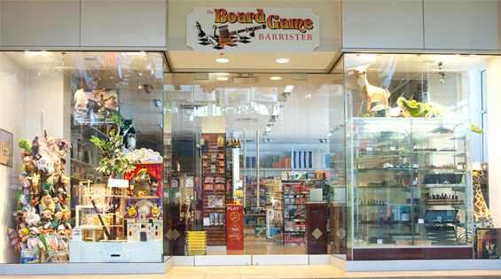
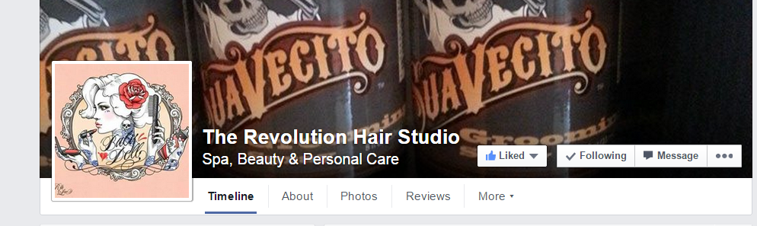
NEW BUSINESS
Notes:
It’s a new businesses story …
Since spring, here are a few have either opened or announced plans to open …
MKE City Sippers
Board Game Barrister
Wild Flour Bakery
Mears Online Auctions retail storefront
Graveyard Records
Just announced today … Revolution Hair Studios … specializing in old-time hair styles … moving from Bay View because the owner told me, “I really want to put my Salon and South Milwaukee on the map as a destination.”
And more to come …

Slide 5

Downtown market
Notes:
It’s a story about the largest farmers’ market between Milwaukee and Kenosha …
One that regularly features more than 50 vendors selling produce, organics, arts, crafts, baked goods, prepared food and more … and a weekly concert series … and other special events …
Bringing hundreds of people downtown every week every Thursday afternoon and evening during the summer.

Slide 6
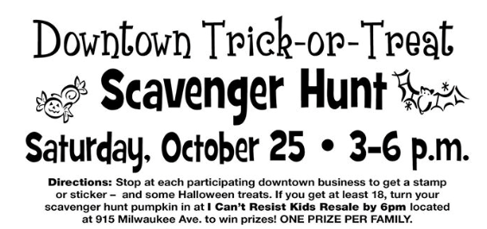

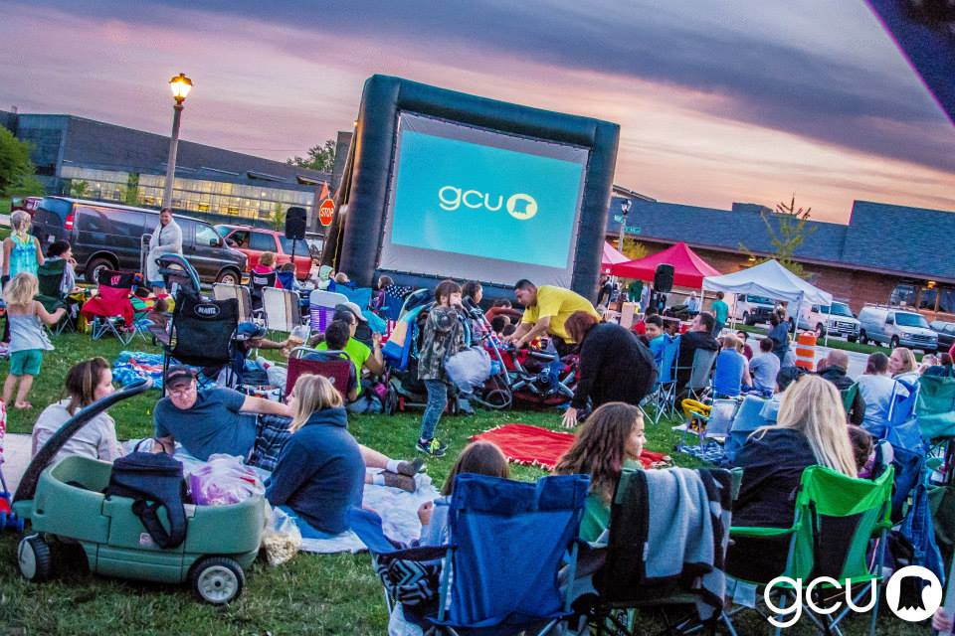
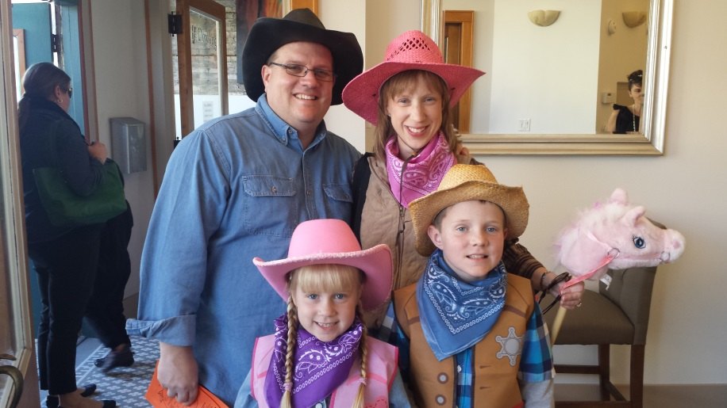
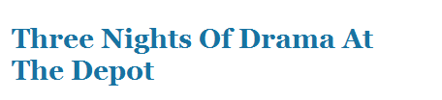

BUSINESS-BUILDING events
Notes:
It’s a story about events … business-and community-building events that set us apart.
Business-building events
Special events throughout the farmers’ market season
Evening on the Avenue … including a partnership with the South Milwaukee Performing Arts Center to bring live performances to our iconic downtown train station
Guardian Credit Union outdoor movies return!
Downtown trick-or-treating event … and our scarecrow public art project
Looking at some new events for 2015, too …

Slide 7
A STORY YET TO BE WRITTEN
Economic development support
  Director funded for 2015
  Single point of contact when it comes to business recruitment, retention and marketing the city
Downtown planning effort
  Priority #1: Develop a plan
  Priority #2: Work the plan
  Money budgeted to do just that
Downtown advisory committee
  Group of business/property owners and residents to advise Plan Commission and City Council on downtown issues
  Will lead development of downtown plan
Notes:
And we’re just getting started in writing that story … the best is yet to come in 2015 and beyond!

Slide 8
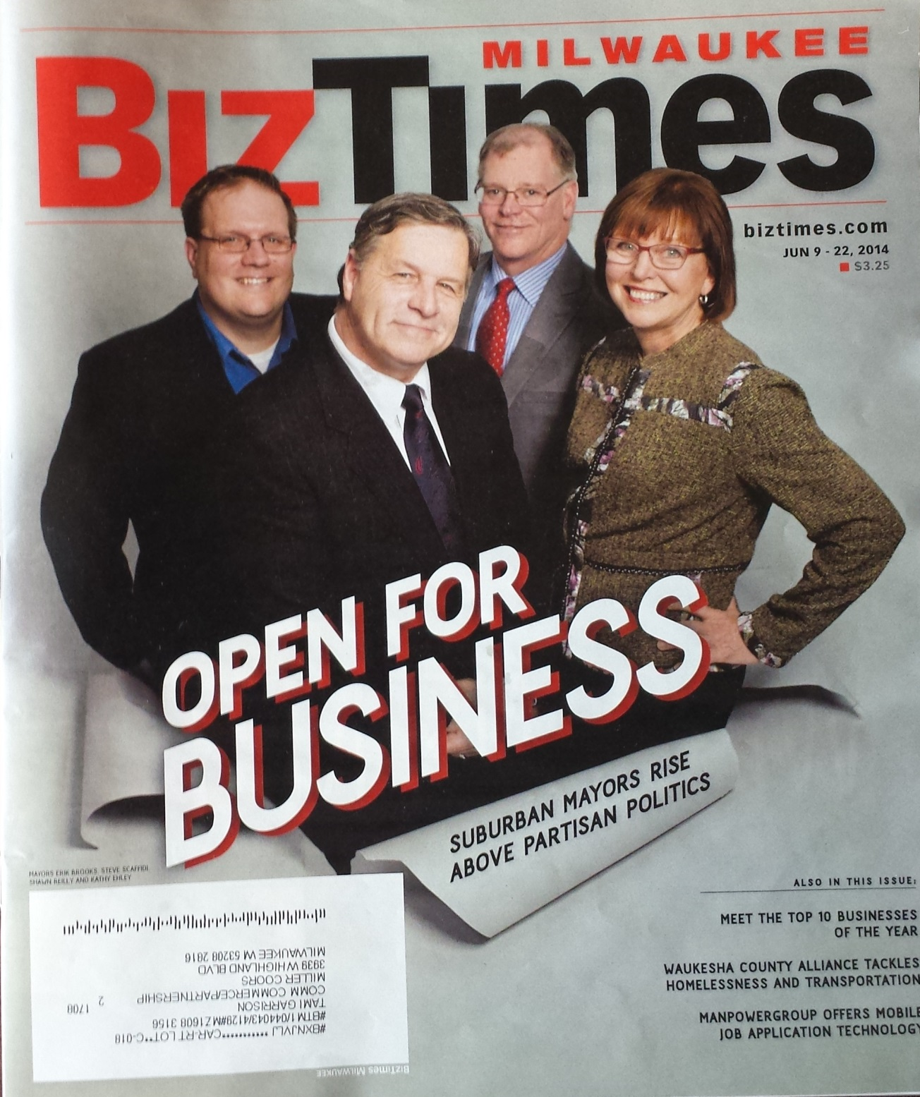
Notes:
So, yes, we’re open for business in South Milwaukee … and we’re excited about what’s to come.
A real opportunity is before us, and I can’t wait for 2015 and beyond.
But don’t take my word for it …

Slide 9
More information
Erik Brooks
Mayor, City of South Milwaukee
Mobile: 414-651-1105
Email: brooks@smwi.org
SouthMilwaukeeBlog.com
Here Tonight
Brett Briesemeister, Briesemeister Realty & Appraisal
Donn Powers, Donn Powers Jeweler
Nicole Maxey, MKE City Sippers
Notes:
Call out that three downtown business owners are here tonight to speak with folks …
Donn Powers
Nicole Maxey
Brett Briesemeister

