Slide 1
SOUTH MILWAUKEE’S PROMISING FUTURE
SOUTH SHORE OPTION 4.0 DEVELOPMENT UPDATE
OCTOBER, 2015
Notes:
ERIK SPEAKS
On behalf of the City of South Milwaukee, I welcome you to South Shore Option 4.0 and to our beautiful South Milwaukee Performing Arts Center.
Thank you to Supervisor Jursik for launching this concept four years and seeing it through to today … your commitment to the South Shore and its growth is apparent in many ways, and this is one of them. Thanks, Pat.
Also, thank you to the South Shore Chamber of Commerce. I am proud member of this organization, and I’m excited to see where it’s come in a relatively short time … and where it’s headed. It is a strong voice for South Shore business, and has a membership truly focused on driving economic development in this region. And I thank the chamber for leading this event tonight.
The PAC is a great place to hold an event like this because this as much as anything is part of our economic development story.
Yes, economic development is about redevelopment sites, programs and strategies … dollars and cents …
But to me it’s more than that. At a high level, it’s a collection of all the things communities do to attract and retail businesses, residents, even visitors. It’s how you as a community lean into what makes you special, and how you tell that story.
And the PAC is one of those institutions that sets us apart. Founded more than a decade ago now, it a community treasure that helps put South Milwaukee and the South Shore on the map. It hosts more than 500 events a year – think of that, 500 – and really punches above its weight when it comes to attracting unique and big-name entertainment …
In fact, last weekend they had lumberjacks throwing axes on this same stage as part of Cirque Alfonse, right? And coming up soon our performances from classic rock legends like the Zombies, Jessie Cooke and Jon Anderson and Jean-Luc Ponty of Yes. Really cool stuff.
So, thank you to executive director Rachel Sorce and her team for hosting us tonight.

Slide 2
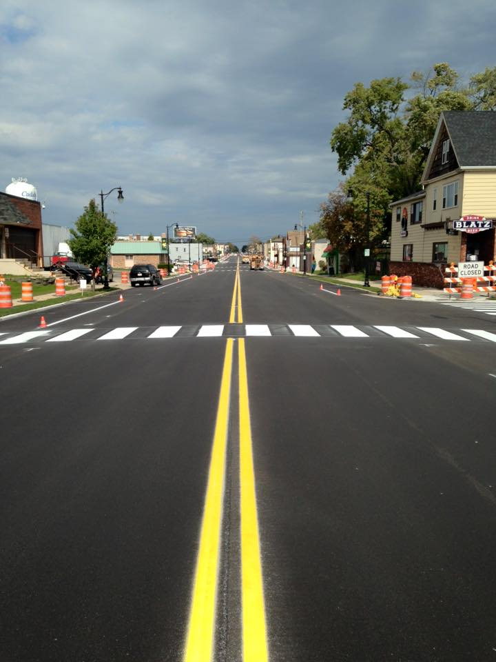
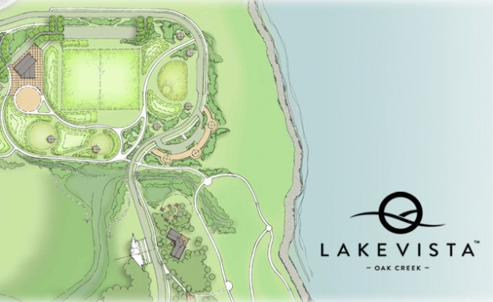
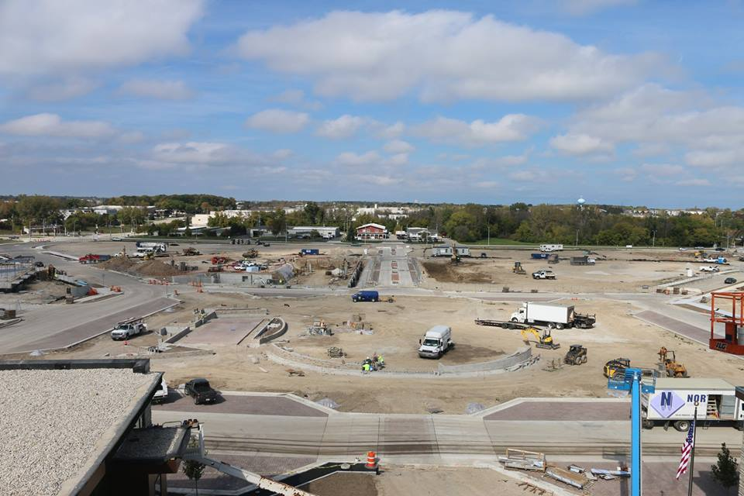
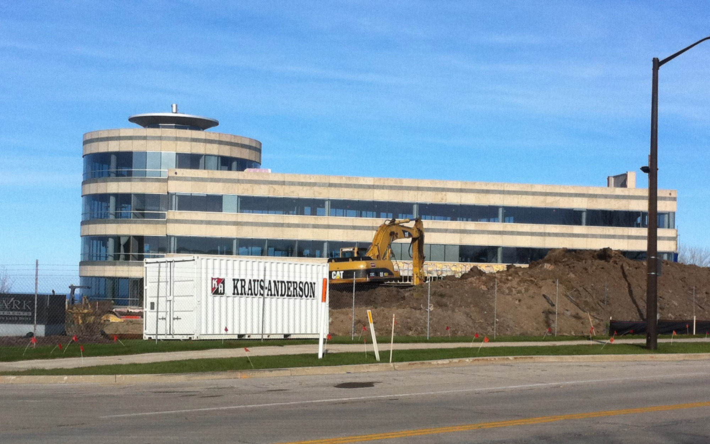
WINNING TOGETHER
Cudahy
Oak Creek
St. Francis
Notes:
Economic development is also about cooperation, working together to lift not just your city, but an entire area and region.
That’s why I’m excited about what you’ll hear from our neighbors tonight …
The entire South Shore wins when St. Francis attracts the lakefront development it is … or when Cudahy invests in downtown streetscaping … or when Oak Creek sees the explosive development it is seeing.
I celebrate that. And I know my colleagues celebrate what we’re doing in South Milwaukee … because we all know that we’re not in this alone. We can’t be, or we’ll never realize the full potential of the South Shore.

Slide 3
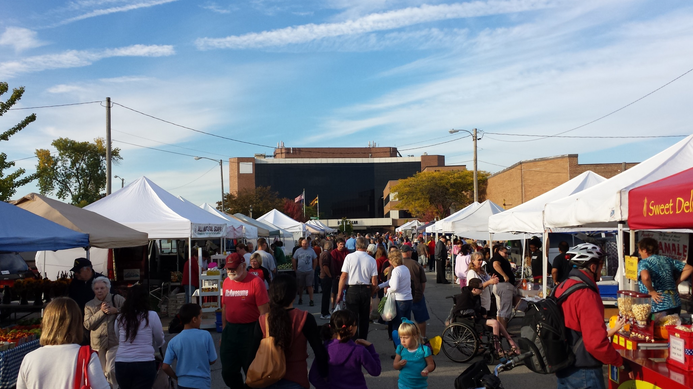
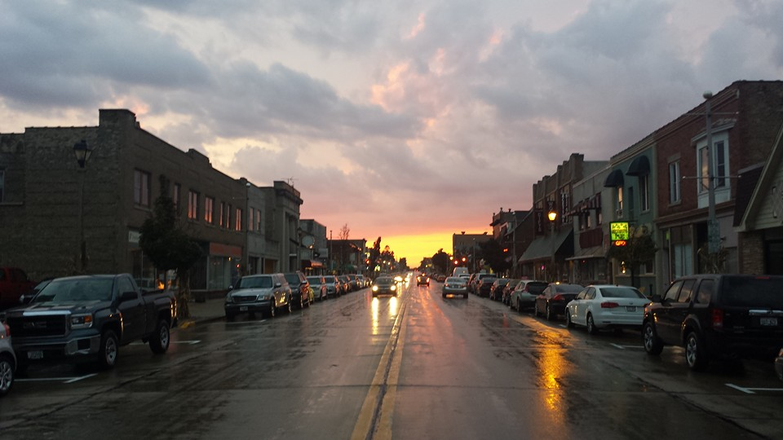
BUILDING MOMENTUM
NEW AND GROWING BUSINESS
INVESTING IN OUR PUBLIC SPACES
PLANNING TO WIN
REDEVELOPMENT OPPORTUNITY
DOWNTOWN FOCUS
Notes:
So, what are we doing in South Milwaukee? A lot.
We’re building momentum, and we’re excited about what’s already happening, and where we’re headed.
Tonight, we’ll talk about five key areas. [Read slide]
We’re putting more emphasis on economic development than we have in a long, long time, and we’re already starting to see the fruits of that labor. One way we’ve done that -- manpower. We added a dedicated economic development coordinator earlier this year … a single person devoted to the day-to-day work of attracting and retaining business.
You’ll hear more from Robin Grams in a second.

Slide 4

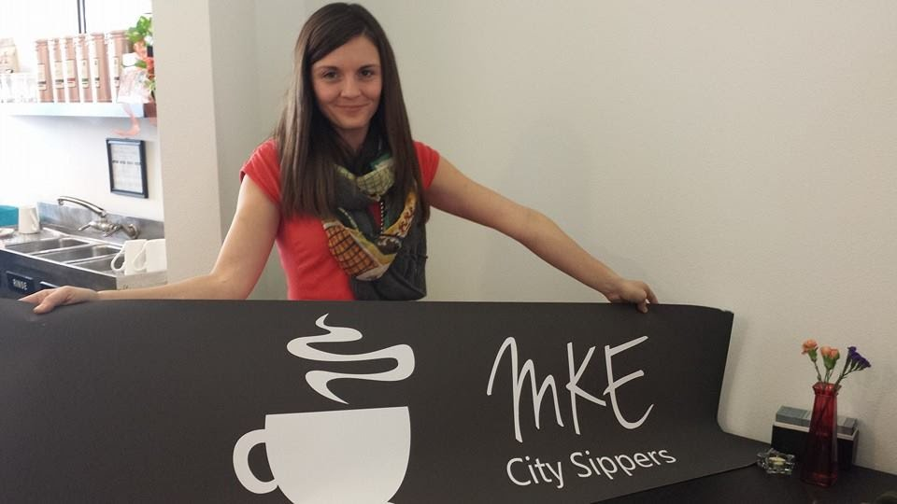
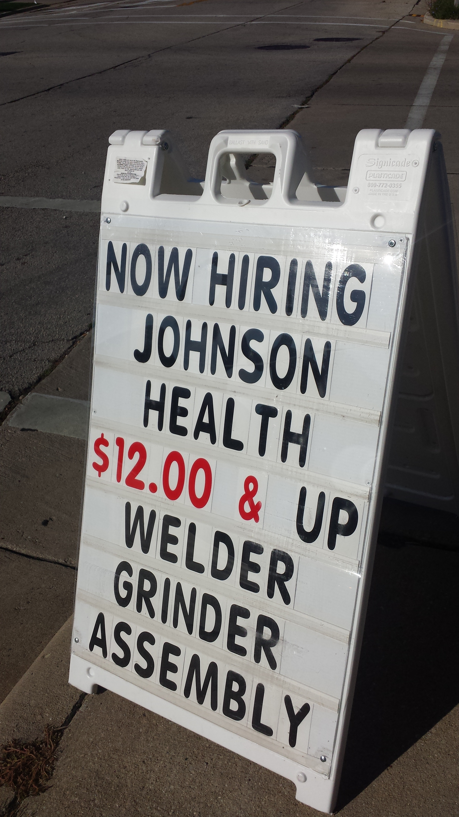
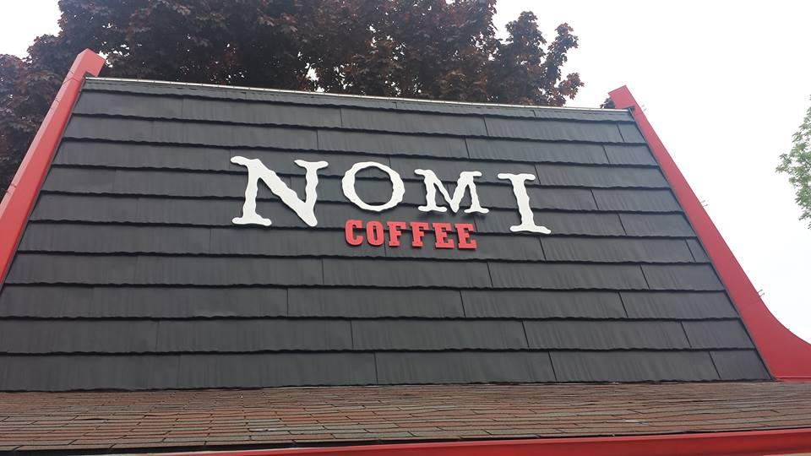

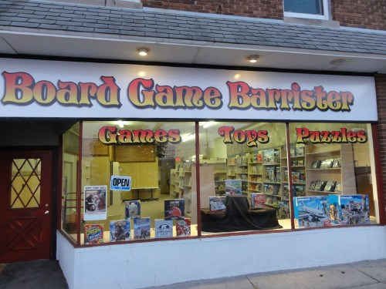
NEW AND GROWING BUSINESS
20+ NEW BUSINESSES IN THE LAST YEAR
Notes:
We take that commitment to attracting and retaining business seriously. I personally spend a lot of time on it, trying to connect people with properties and making sure our strongest existing businesses have what they need to grow in South Milwaukee.
And we’re already seeing the fruits of this labor.
Among those that have opened in the past year …
Two new local coffee houses
Revolution Hair Studio (relocated from Bay View and already expanding, just signed a new three-year lease)
Other new downtown business (party store, convenience store, gas station, t-shirt shop)
New business at Grant Park Plaza (including Planet Fitness, Galaxy Furniture)
How many suburban American strip shopping centers can boast of almost full occupancy? We can.
Burger King now under construction …
Two new Milwaukee Avenue businesses coming online soon: Grillworks and a new candy and collectibles store
And Papa Luigi’s taking is taking steps to reopen fully in 2016!
Of course, Caterpillar continues to struggle in a difficult global environment for mining … and, while I wish they didn’t have to close their Oak Creek facility to do it, they strengthened their commitment to South Milwaukee with the announcement a couple weeks ago about the return of around 200 jobs downtown.
Business is better for other local manufacturers, including Johnson Health Tech … as it looks to grow from 60 to over 100 employees, as it recently expanded to 250,000 square feet downtown as they manufacturer and ship exercise equipment around the world.

Slide 5
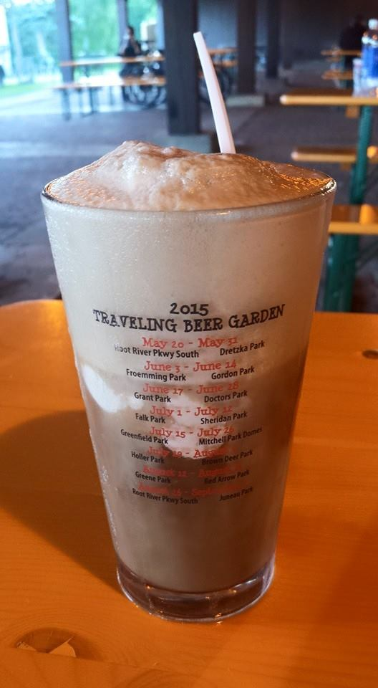
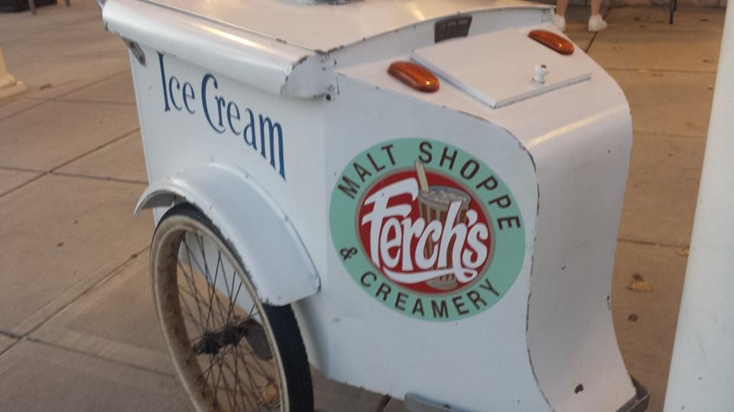
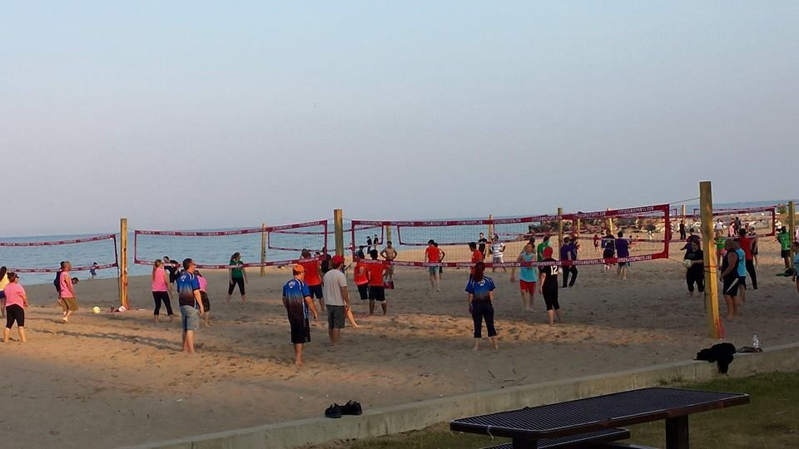
INVESTING IN OUR PUBLIC SPACES
NEW LIFE AT GRANT PARK
RESTORING OAK CREEK WATERSHED
BEAUTIFICATION COMMITTEE
GROWING SOUTH MILWAUKEE
Notes:
There is also a LOT of investment happening in our parks and other green spaces.
And as we look to attract and retain residents, businesses and visitors, this is a terrific part of our story in South Milwaukee.
I’ll start with all the investment happening in Grant Park.
Beach volleyball, Ferch’s, Oak Leaf Trail upgrades, beer garden success!

Slide 6
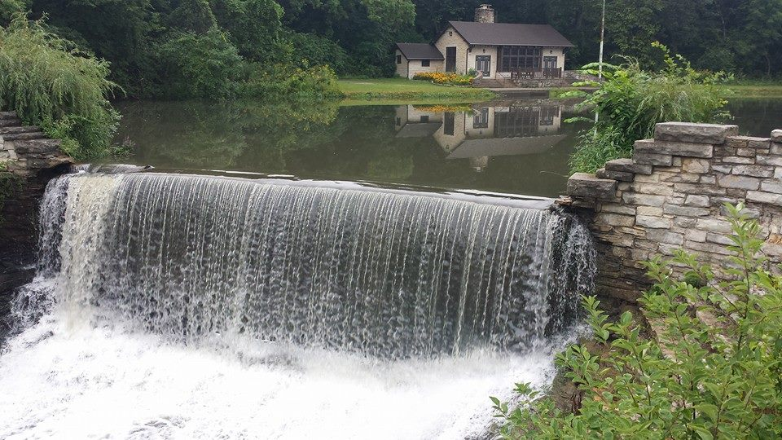
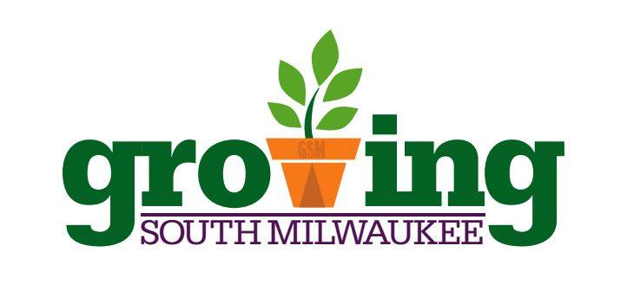
INVESTING IN OUR PUBLIC SPACES
NEW LIFE AT GRANT PARK
RESTORING OAK CREEK WATERSHED
BEAUTIFICATION COMMITTEE
GROWING SOUTH MILWAUKEE
Notes:
We’re also poised to make significant investments in the Oak Creek watershed …
We’ve spend the better part of a year lining up support for a watershed restoration effort, bringing together the six communities of the Oak Creek watershed, the county and MMSD around a common goal of bringing vitality back to this natural resource.
And I’m happy to announce we’re almost there … money toward this half-million dollar effort is included in the budgets of key funding sources, and we’ll cross our fingers it stays there.
The goal: Develop a scientific study around the of this resource … and unite everyone in the watershed around the effort, bringing people together to restore vitality to this wonderful natural resource.
We’re also working hard on beautifying our city. We just formed a city-sponsored Beautification Committee, a group that is passionate about areas like seasonal streetscaping, urban forestry, public plantings, community cleanups, and other ways we can make South Milwaukee a more beautiful place. Their first project: Christmas decorations around the city, especially downtown. You’ll see the fruits of their this holiday season.
Then there is Growing South Milwaukee, a grassroots organization that has formed to start a community garden in 2016, likely downtown.
So lots happening in the short, medium and long term when it comes to our public spaces … and there is a lot more to come.

Slide 7
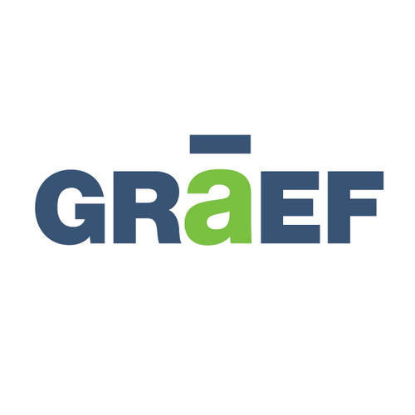
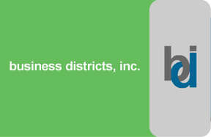
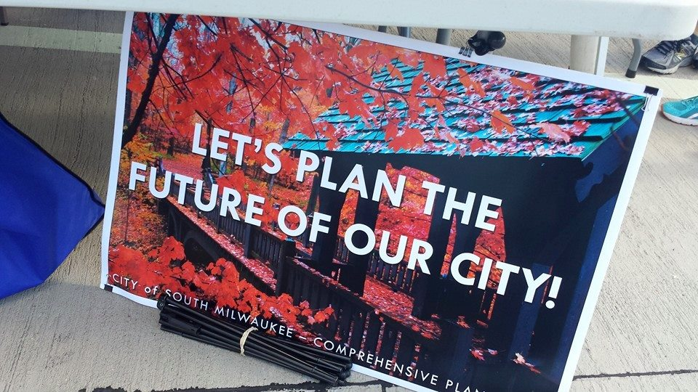
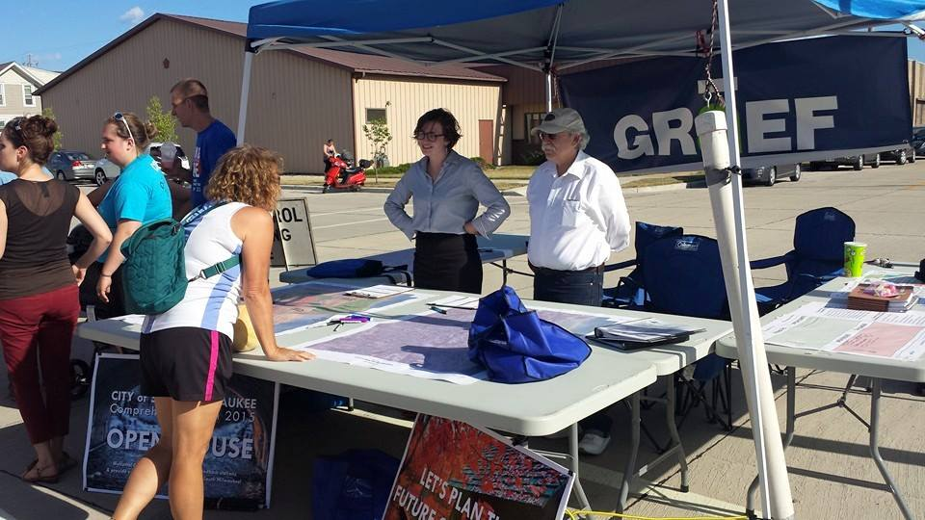
PLANNING TO WIN
UPDATING OUR COMPREHENSIVE PLAN
CREATING A DOWNTOWN PLAN
“Build a plan, then work the plan.”
Notes:
Our planning efforts will inform our decisions going forward … and we’re making big investments in this area, too.
ROBIN SPEAKS
Update on our downtown and comprehensive planning efforts …
Key message: We are laying the foundation for future growth by updating our comprehensive plan and delivering a focused plan downtown for the first time. These plans won’t sit on the shelf. We will work them, from day one. In fact, we’re already starting to use some of the early thinking in driving economic development in South Milwaukee.

Slide 8
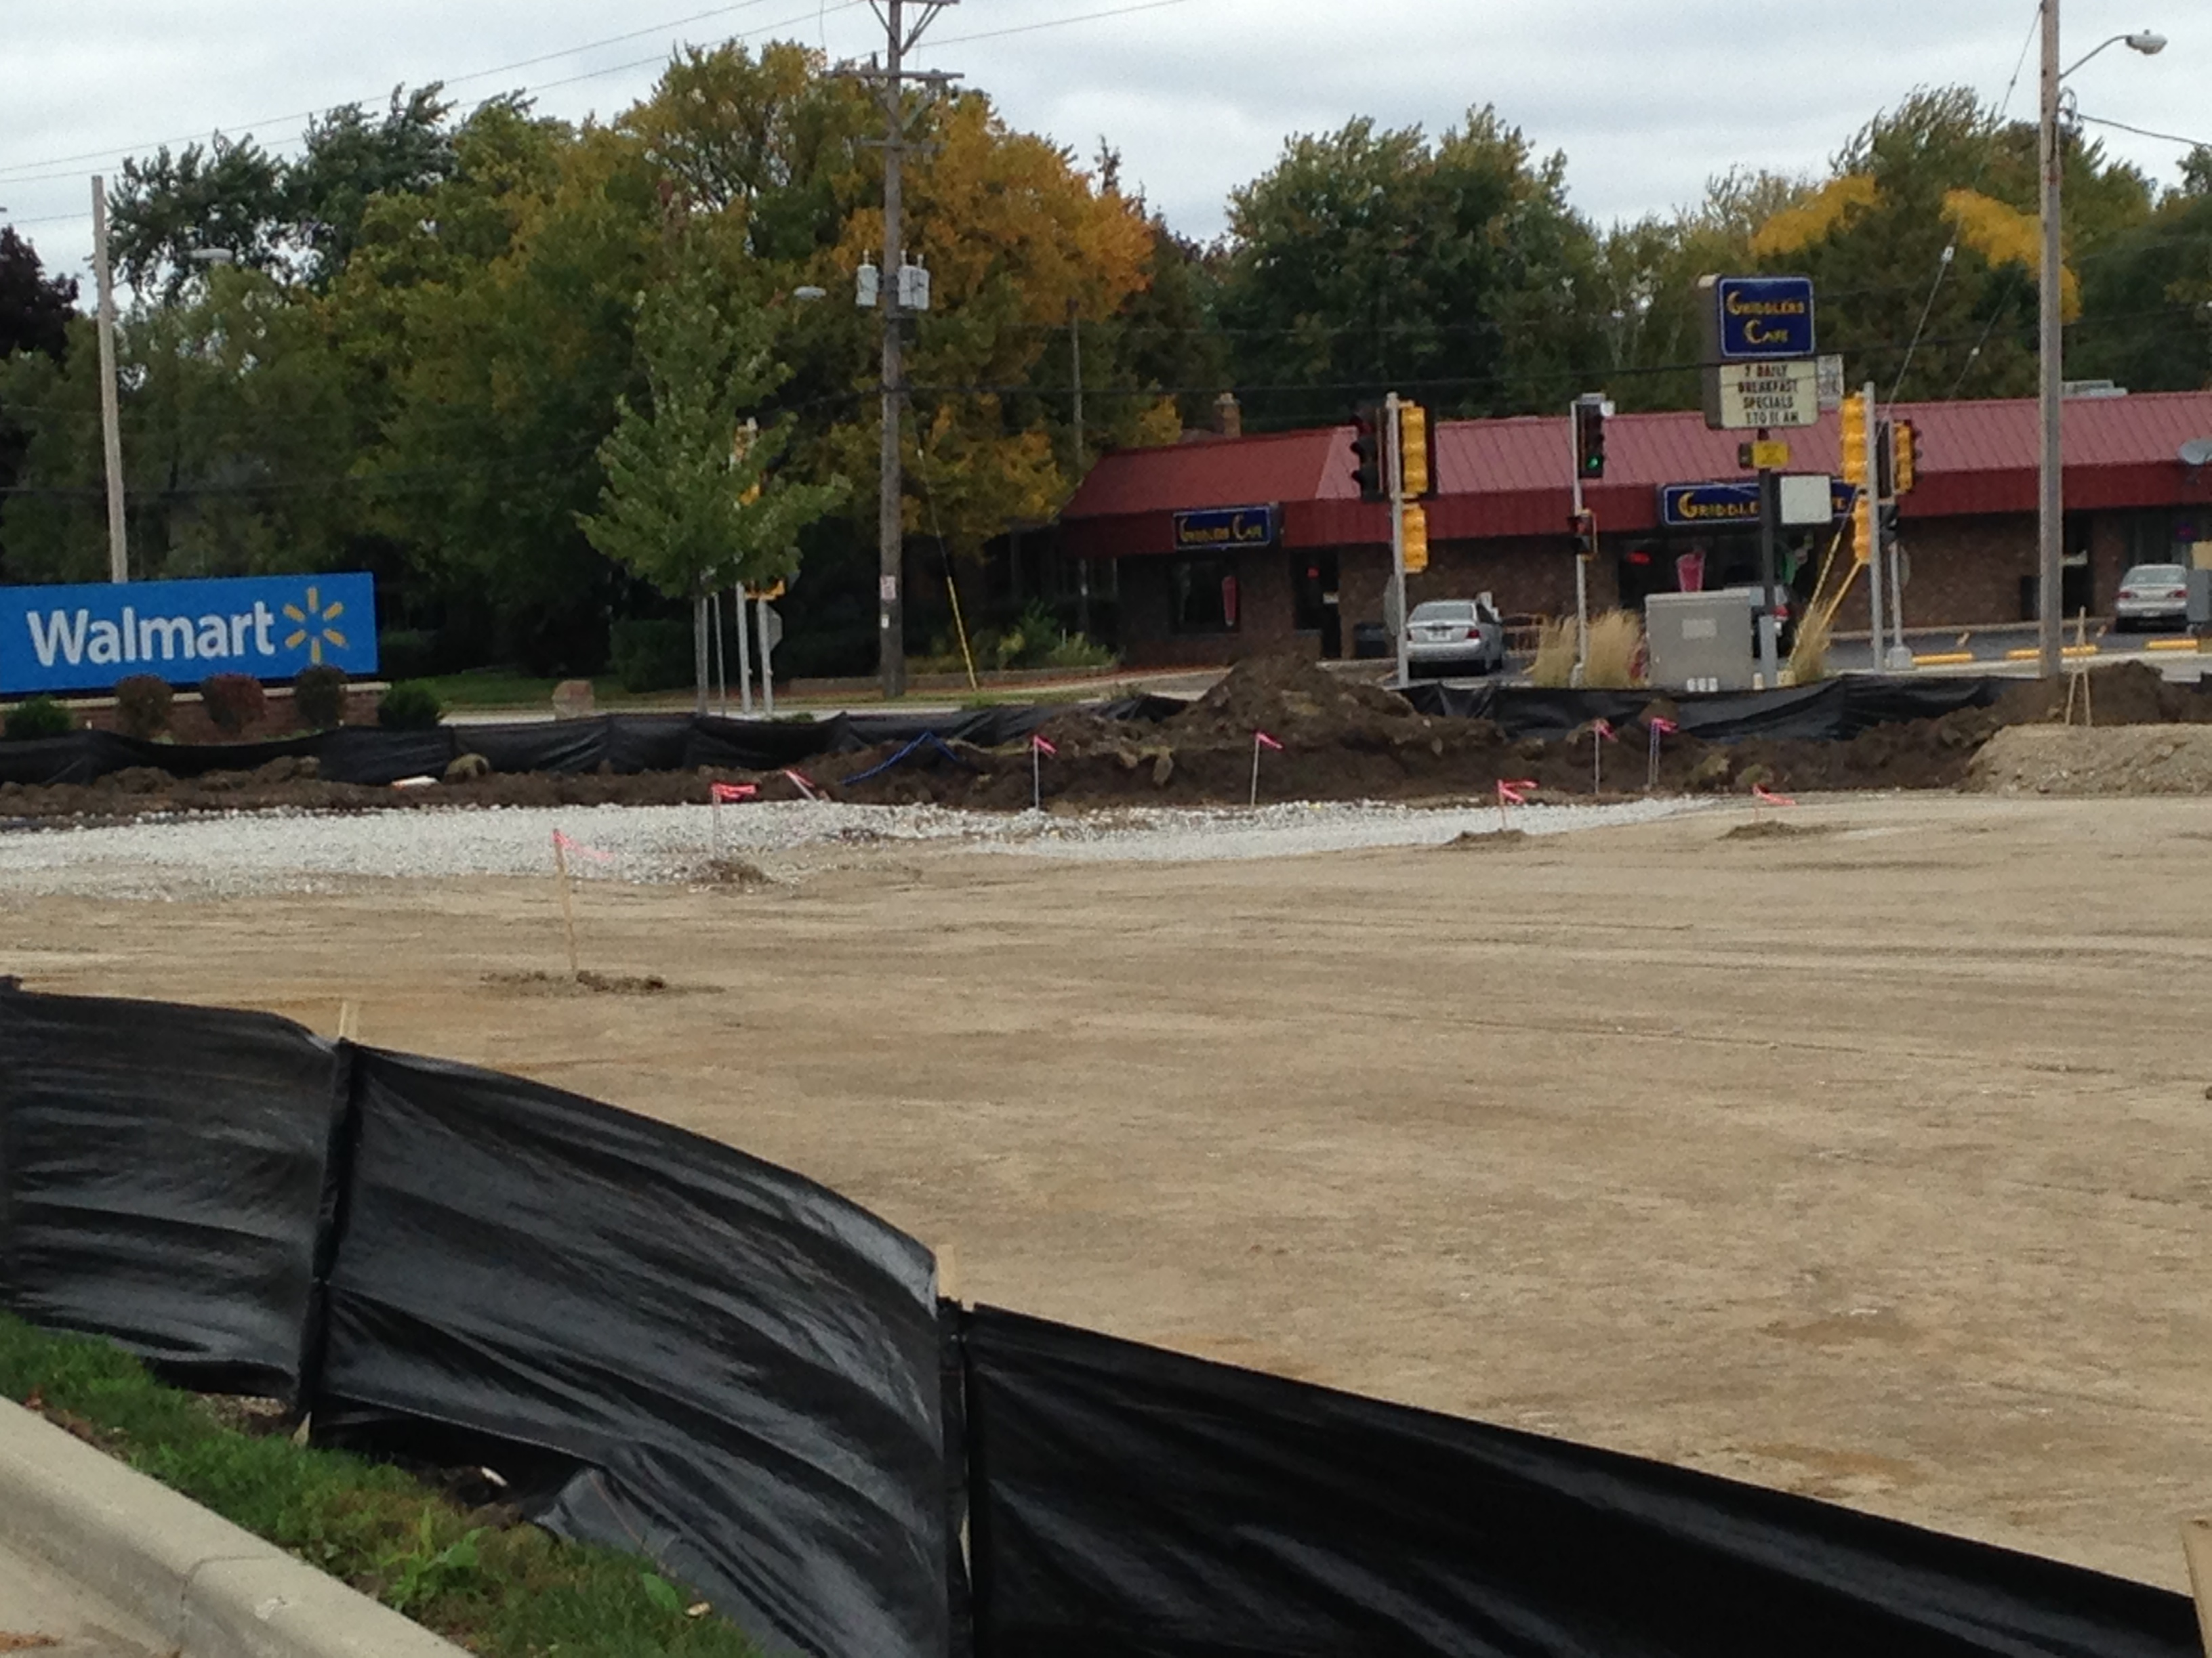
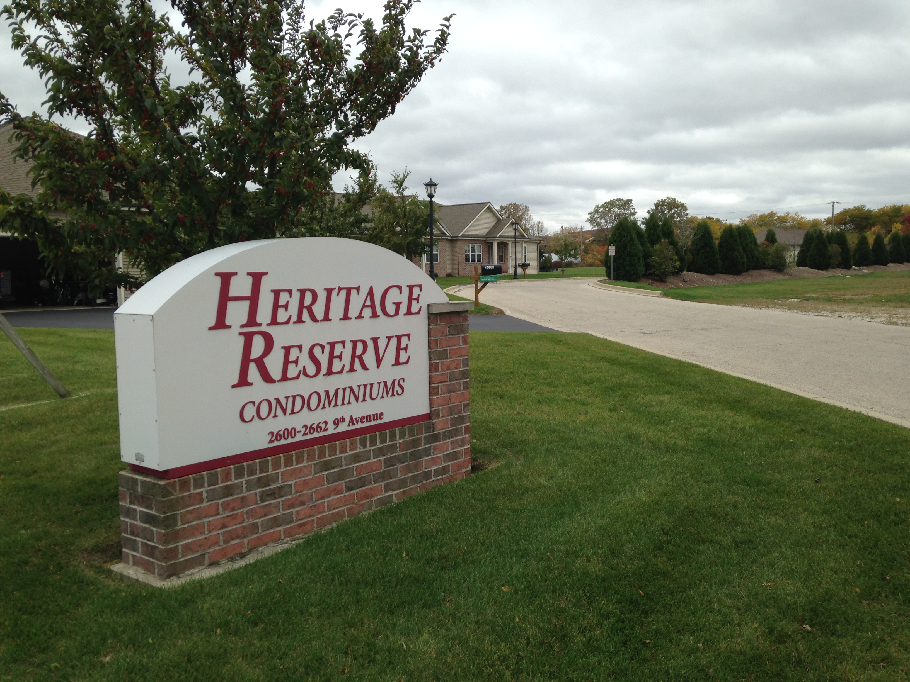
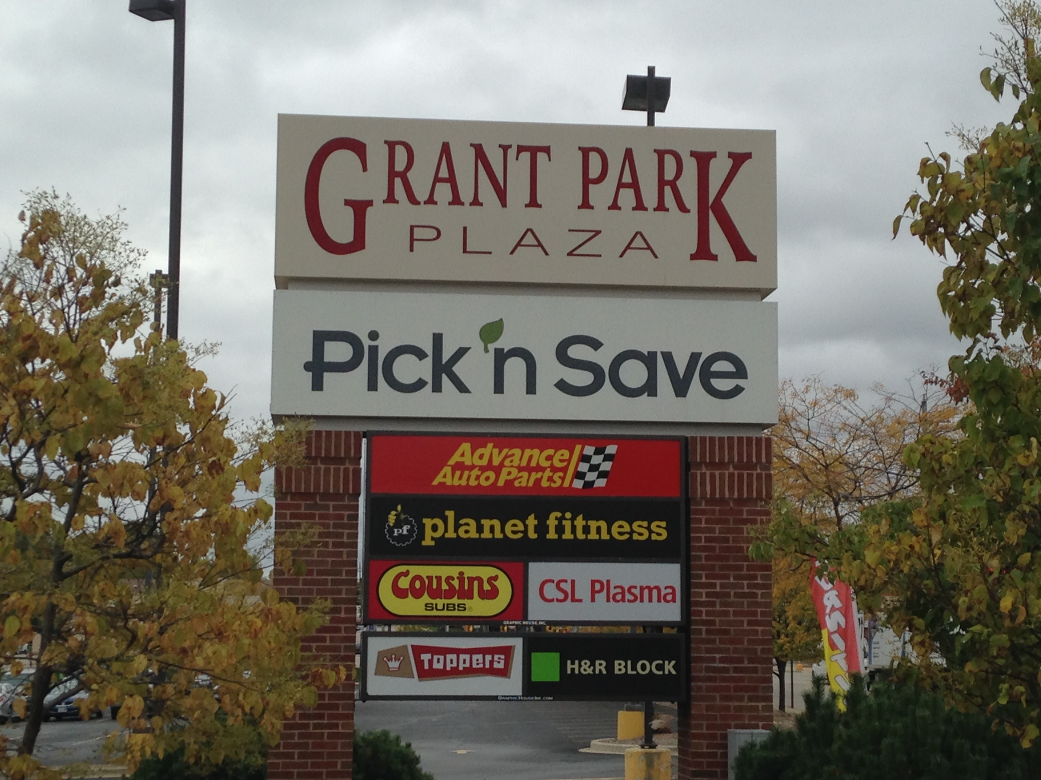
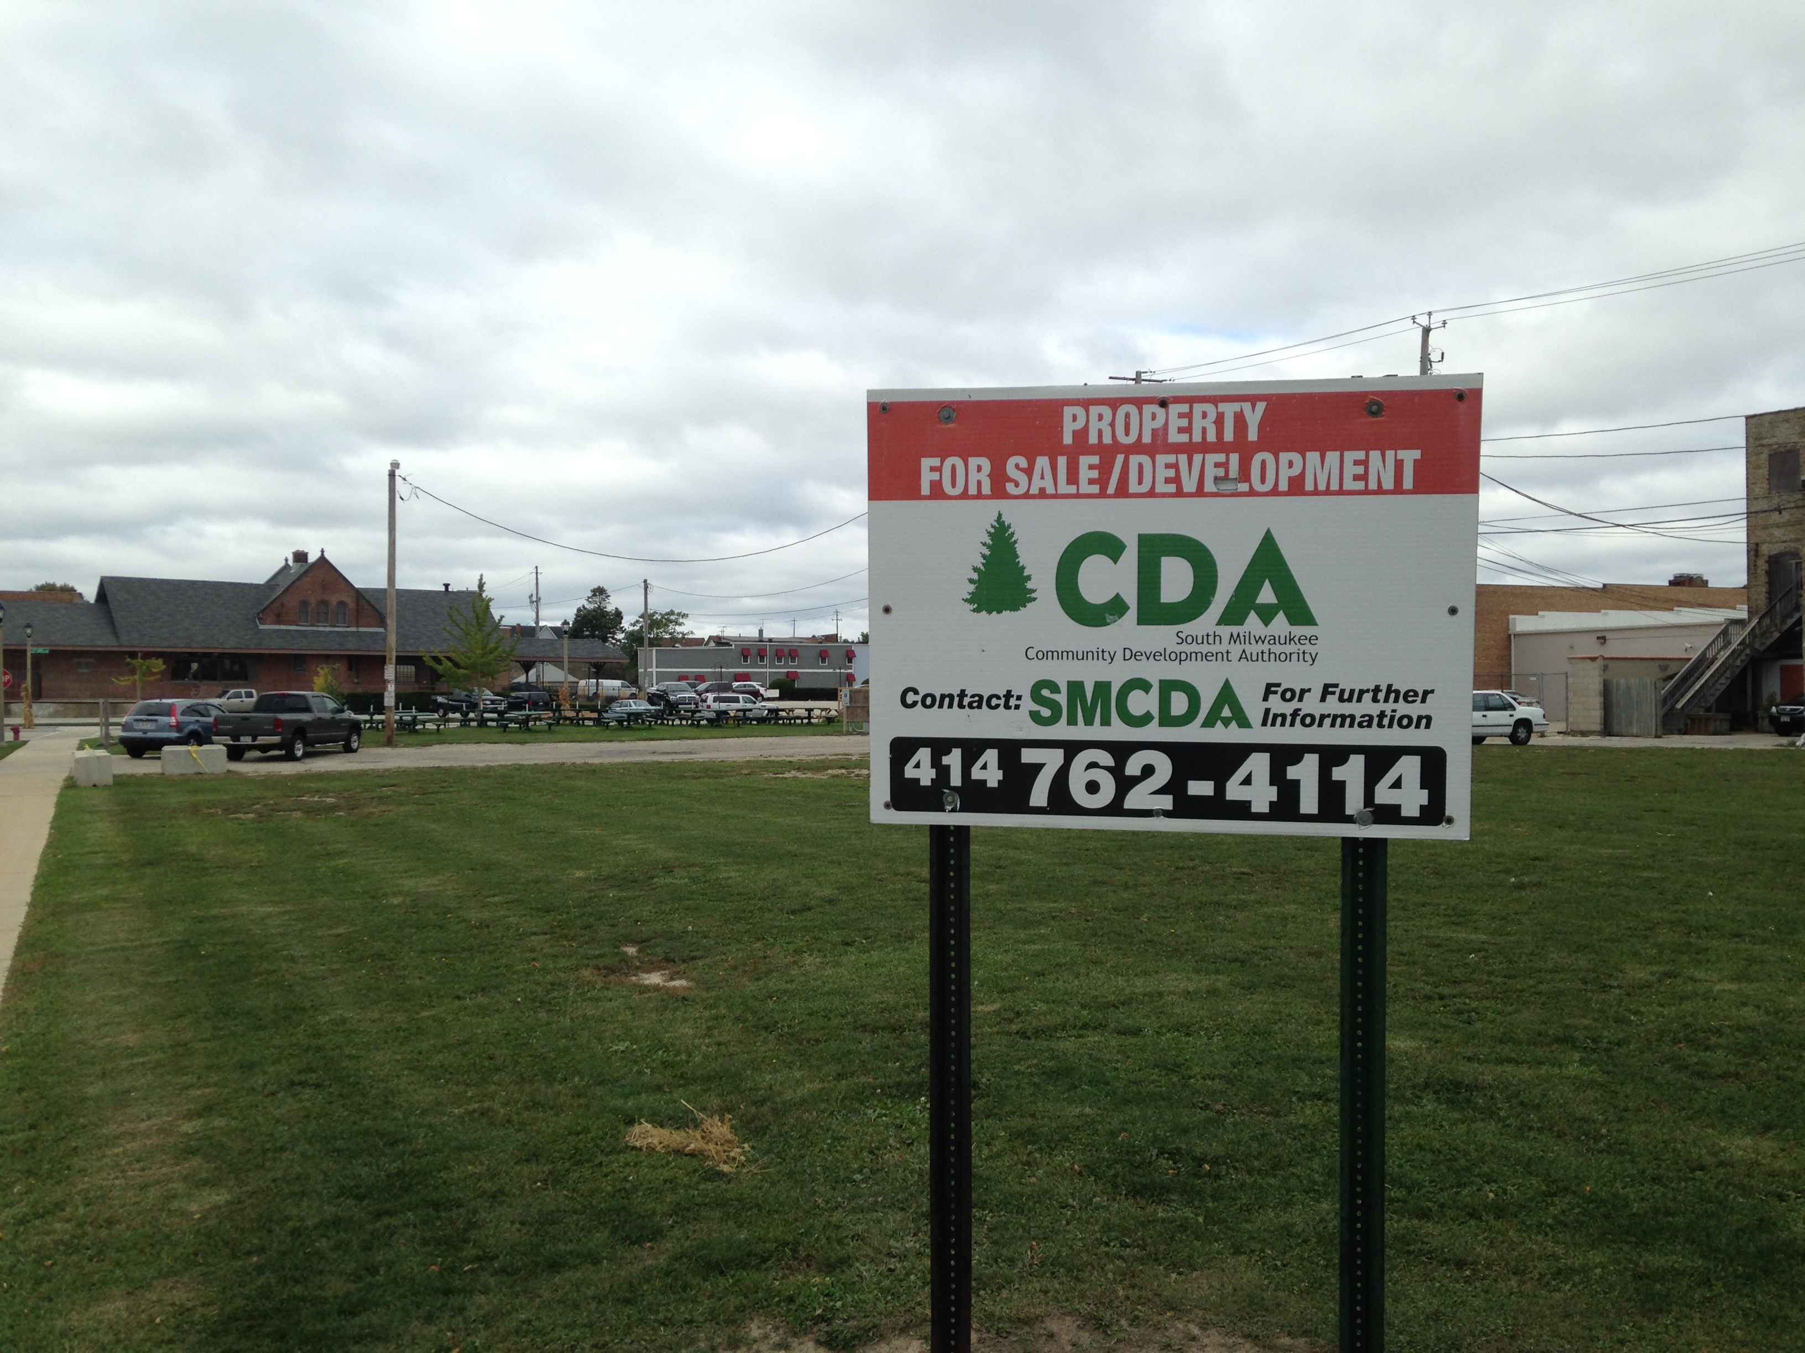
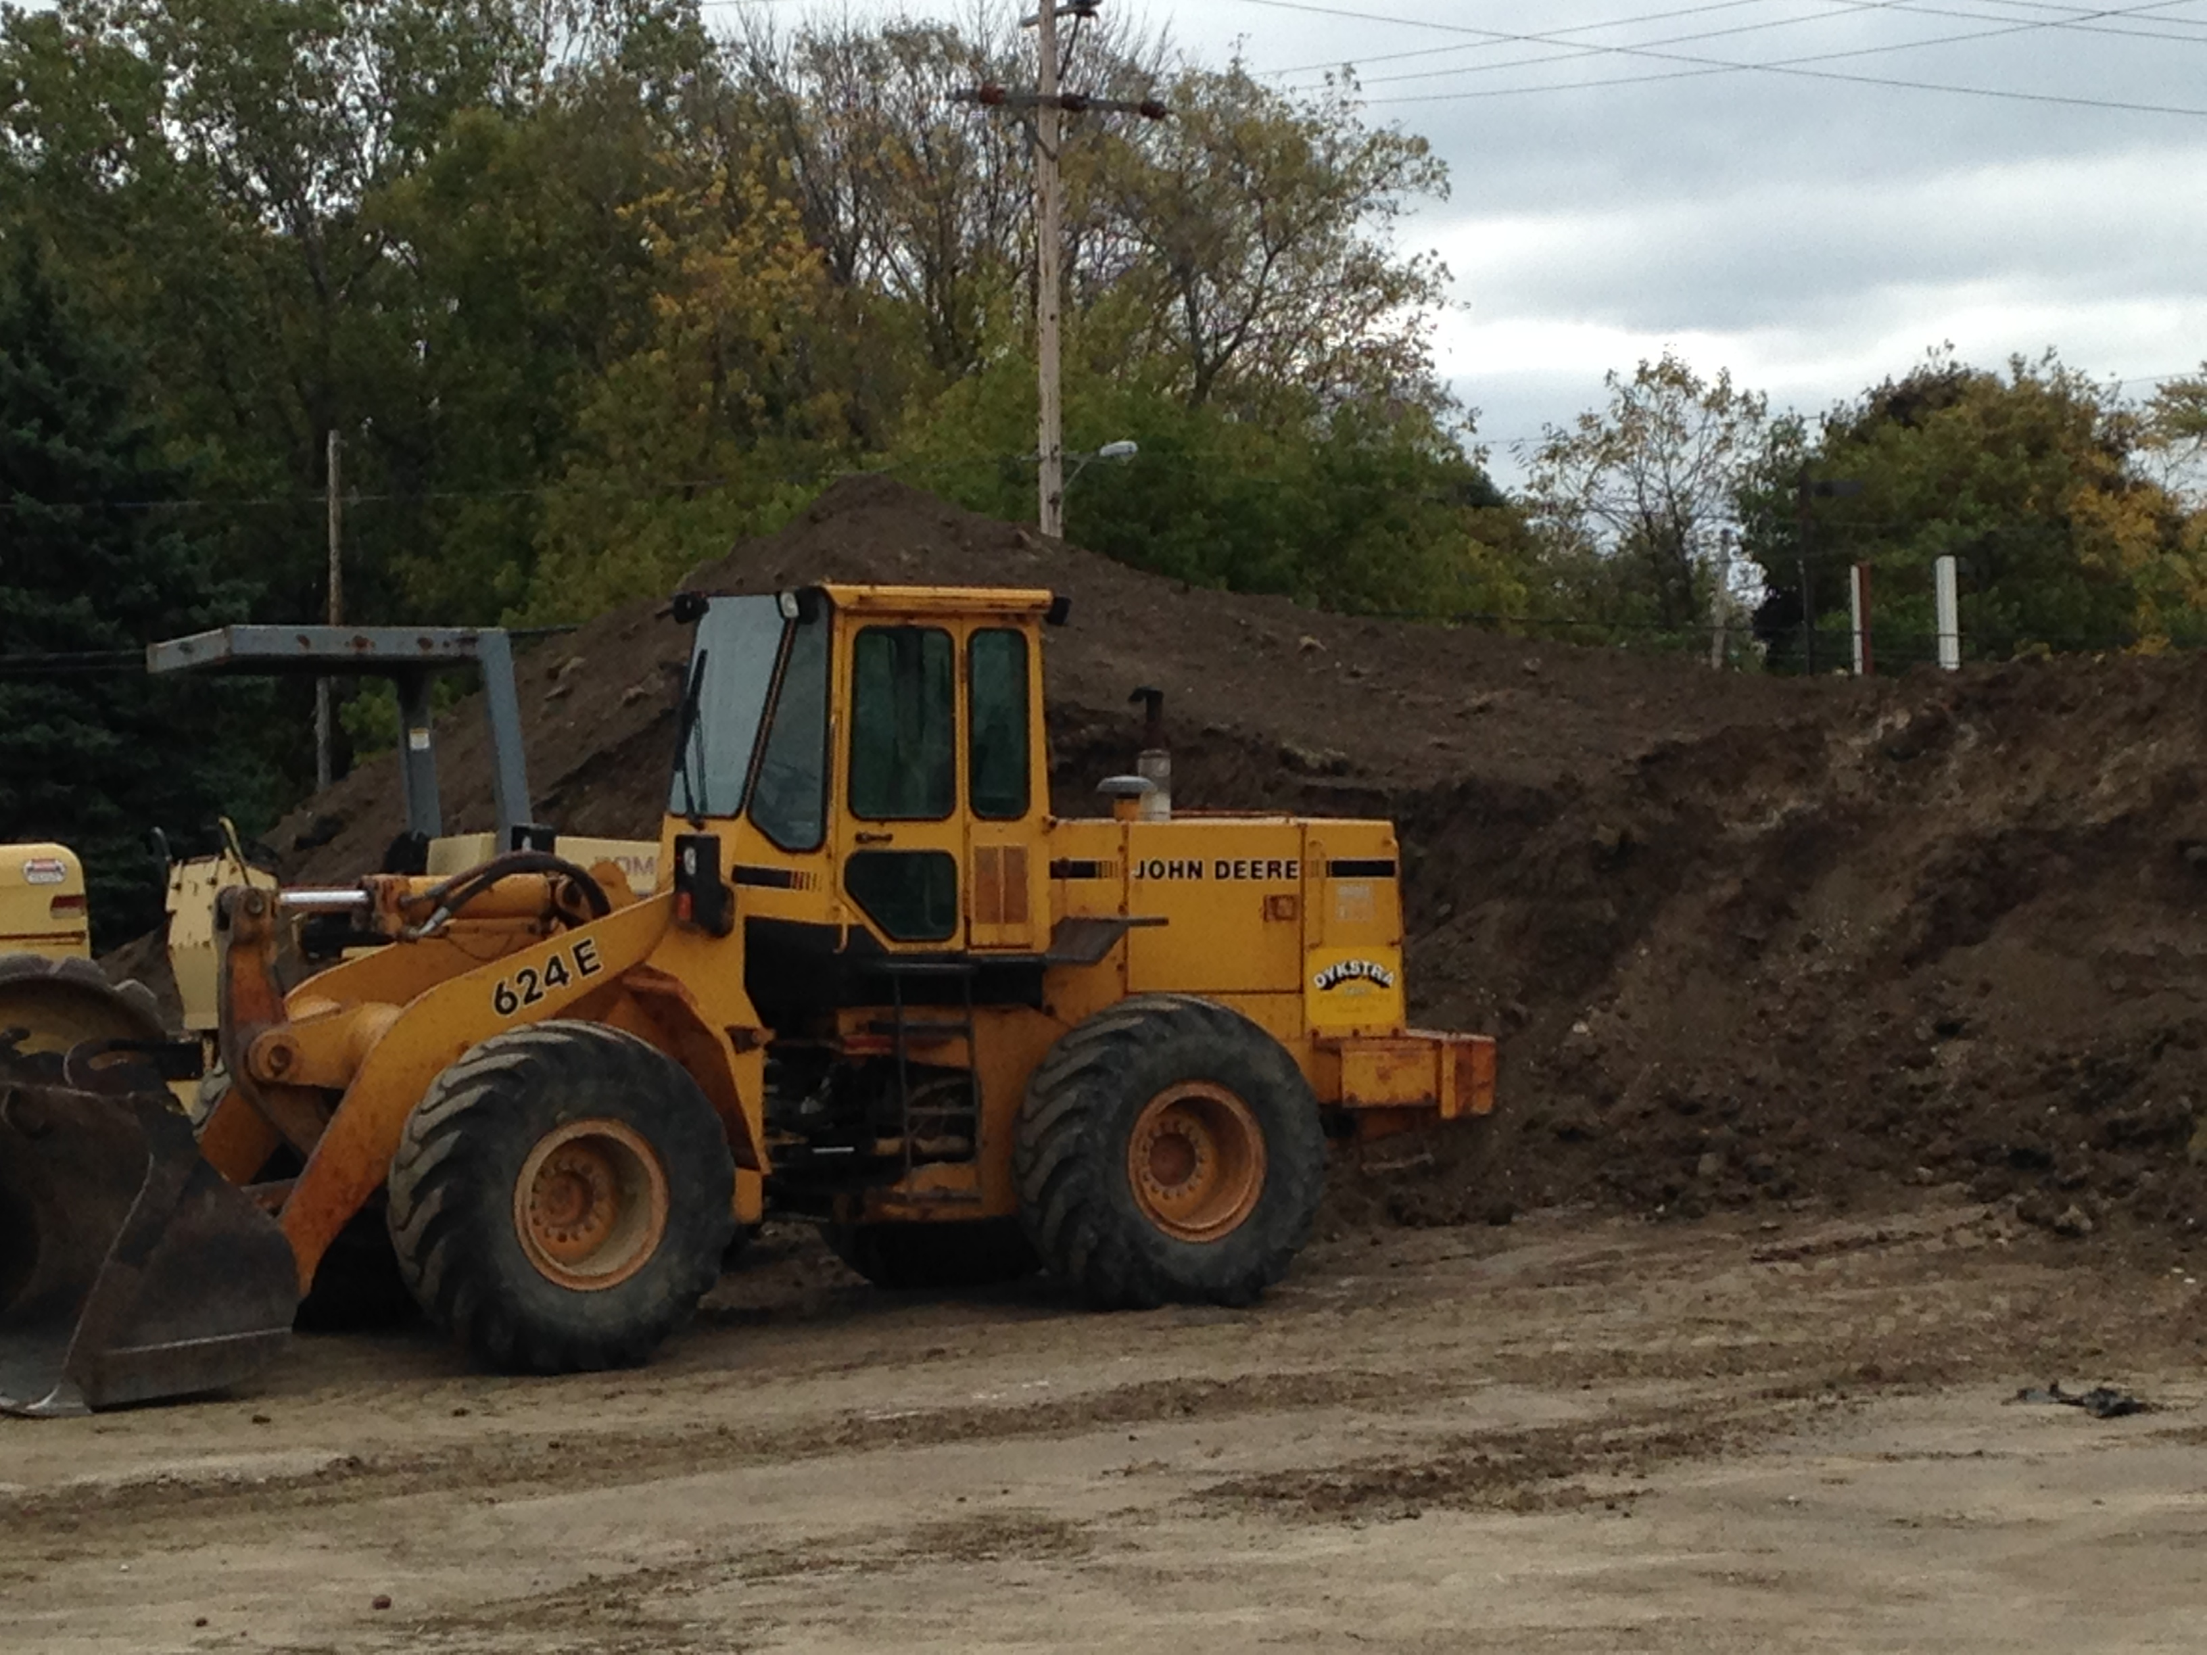
REDEVELOPMENT OPPORTUNITY
Notes:
ERIK SPEAKS
Thanks, Robin. As part of that planning effort, we’re taking a hard look at a number opportunity parcels around the city.
The key message here: We have a variety of parcels in play to suit a number of development and redevelopment opportunities.
To me, it all starts with small businesses, and we’re are always looking to connect potential business owners with affordable property be it downtown or outside of our city center.
As I mentioned earlier, we’re seeing some of the fruits of that labor now, but we have a lot of road left … with our planning efforts will help us build that roadmap for the future.
We also have opportunities for bigger developments, along the lines of what you see in the photos …
TIFs – 3 development districts that present some unique opportunities for developers throughout the city
South of Milwaukee Avenue
North side of the city – Walmart, Burger King
South side of the city – Grant Park Plaza
We’re also taking a hard look at opportunity areas like …
Land surrounding the Oak Creek Park
The former AMF … 7 acres located just blocks from Grant Park
No matter what type of property you are looking for, the amenities are clear in South Milwaukee: Affordable real estate, both for sale or lease; proximity to the major transportation hubs; great schools; terrific parks and other public spaces; events that are second to none; and a feeling of community that just can’t get in all places.

Slide 9
DOWNTOWN FOCUS
Notes:
Our biggest opportunity? It’s downtown.
We’re putting more focus than ever on our city center, and for good reason: As downtown goes, so goes South Milwaukee.
It’s a huge redevelopment opportunity … one that is still in many ways in its infancy.
The vision is simple: Bring our city center back to life, delivering a renewed energy downtown built around locally owned business, sought-after residences, terrific public spaces and memorable events.
And we’re making progress. New sustainable businesses have opened in the past year, several new ones are coming online in coming months, and several existing businesses are planning expansions.
I already mentioned a few of them earlier, like Revolution Hair Studio and MKE City Sippers and Board Game Barrister and new businesses like the candy store and supper club-style restaurant coming online.
I’ll add another here … Styled Aesthetic, a screen printing business on Milwaukee Avenue founded by two Franklin High School graduates that is building out its South Milwaukee Rocket apparel store while also adding equipment and employees to build out its printing operations … especially around its motorsports operation. I met with these guys last week, and they have big plans for growth, and it’s exciting.
These types of businesses are the future of downtown South Milwaukee.

Slide 10
DOWNTOWN MARKET
Notes:
And let’s not forget about fastest growing downtown business.
The South Milwaukee Downtown Market is the largest farmers’ market between Milwaukee and Kenosha …
One that regularly features more than 50 vendors selling produce, organics, arts, crafts, baked goods, prepared food and more … and a weekly concert series … and other special events …
Bringing hundreds of people downtown every week every Thursday afternoon and evening during the summer.
Investments in 2015 – $20,000 in new picnic tables, a repainted stage area and more.

Slide 11
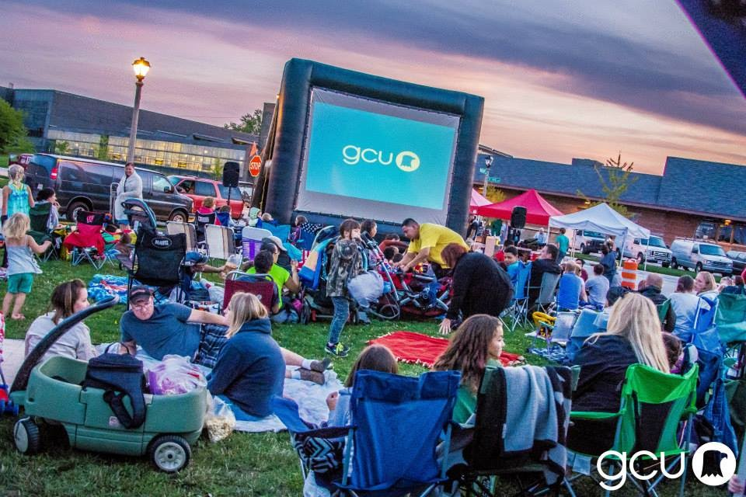
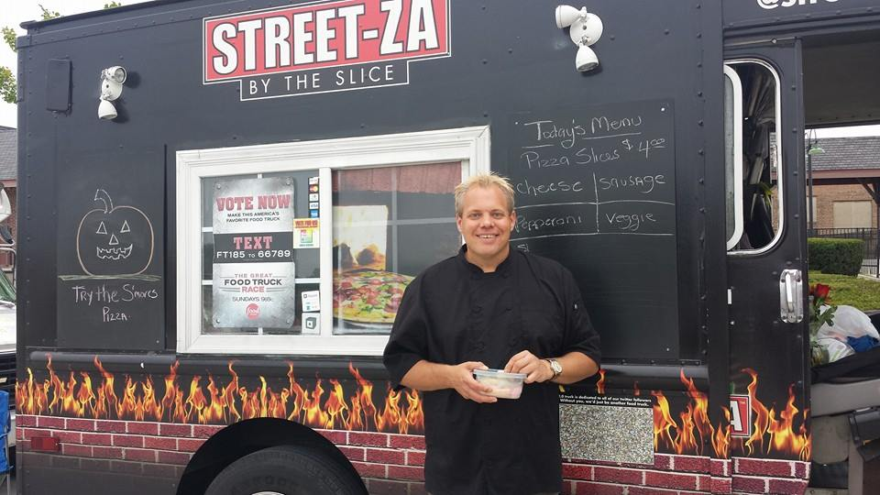
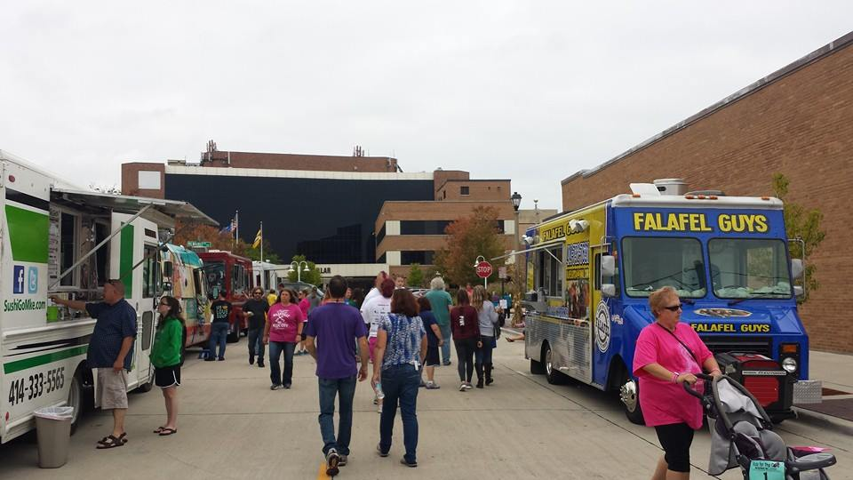
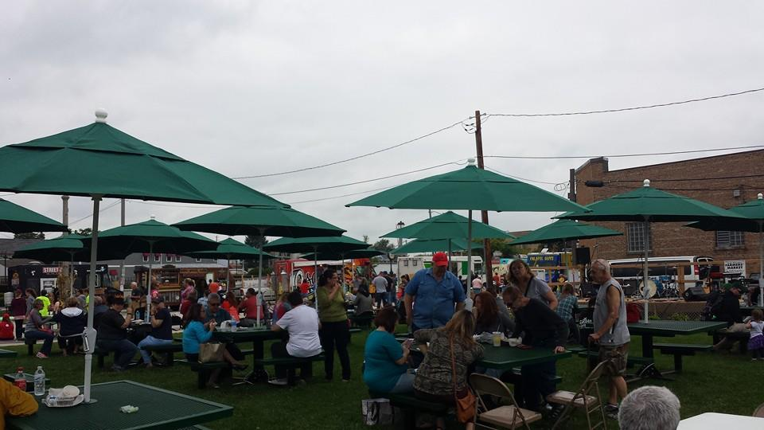
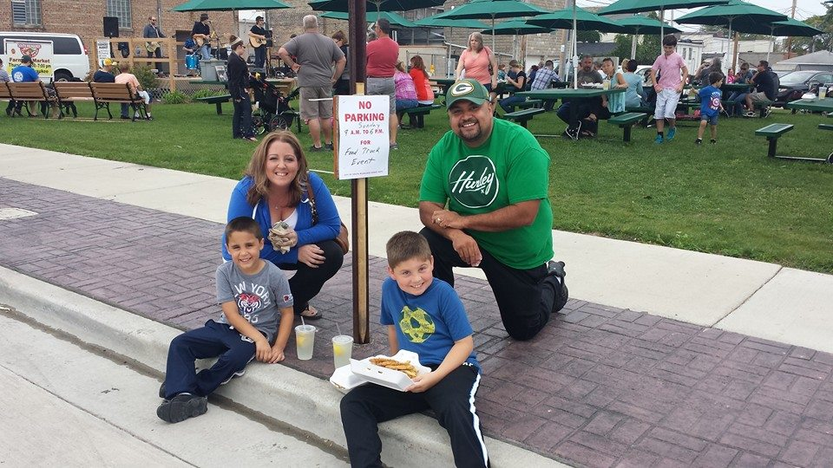
MOVIES! FOOD TRUCKS!
(AND OTHER BUSINESS-BUILDING EVENTS)
Notes:
The market is just one business-and community-building event that sets us apart.
Business-building events
Special events throughout the farmers’ market season
Our new and improved Evening on the Avenue downtown street fair
Guardian Credit Union outdoor movies
Downtown trick-or-treating event … and
Food trucks!
Tell the food truck story!
Two events a year
Thousands come downtown
Led by South Milwaukee’s Scott Baitinger and Streetza Pizza
It was a terrific couple of events, and something that South Milwaukee has never seen before … Really, when is the last time falaffel and sushi were consumed in downtown South Milwaukee at the same time?

Slide 12
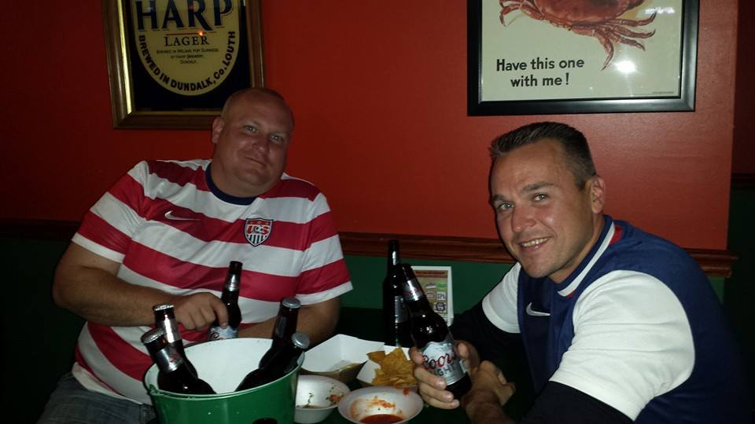
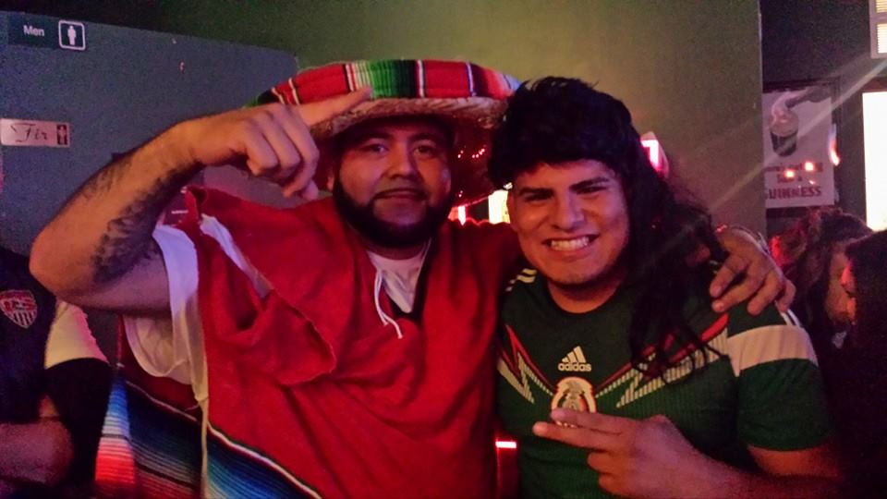
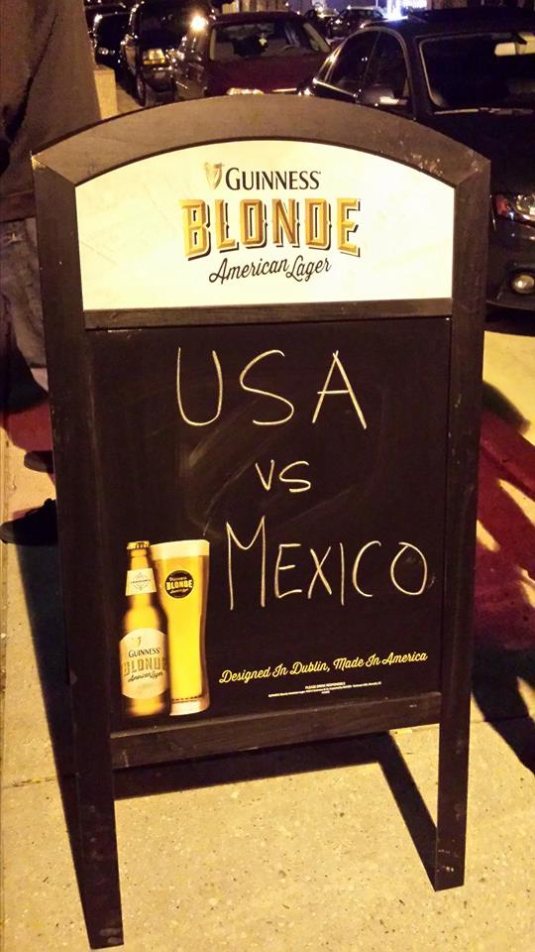
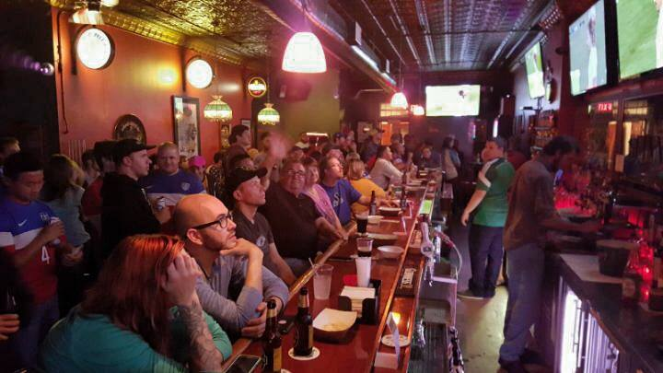
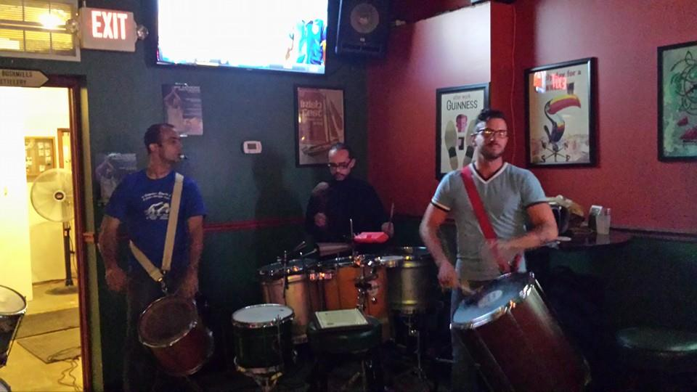
LAST SATURDAY NIGHT …
Notes:
All of this is leading to a new energy downtown … one that was on full display Saturday night.
I want to close with a story about Matt and Mitch. They’re longtime friends from Racine and Muskego who for years have been traveling all the way to Bay View and the Highbury Pub for big soccer games. Then they heard about Moran’s, the downtown South Milwaukee pub which is rebranding as a soccer bar starting this month. That rebranding began with a viewing part of Saturday night’s USA-Mexico men’s soccer game.
Matt and Mitch decided to give Moran’s a try … after first stopping at The Azteca Mexican Restaurant down the block. They had a great time, along with 100 or so others who caught the game at Moran’s. Me included.
I spoke to the crowd briefly before the game, and I asked … how many of you aren’t from South Milwaukee? More than ¾ of the hands went up. Matt and Mitch were two of them.
I had a blast on Saturday. So did Matt and Mitch. I know they’ll be back to catch another game … as will I’m certain many others there that night, and others as they hear about Moran’s.
Jim and Joan Moran founded the bar in 1995 as an Irish pub. Now, 20 years later, it’s evolving into a true destination for our downtown. New TVs, food service, more craft beers, and a business proposition that I know will be a winner.
This is how we’ll turn around downtown South Milwaukee – one business at a time. And we’re doing it. Just ask Mitch and Matt.

Slide 13
MORE INFORMATION
Erik Brooks
Mayor, City of South Milwaukee
Mobile: 414-651-1105
Email: brooks@smwi.org
SouthMilwaukeeBlog.com
Facebook.com/MayorBrooks
Robin Grams
Economic Development Coordinator
Work: 414-762-2222
Email: grams@smwi.org

