Slide 1


South Milwaukee Unite Against Drug Abuse
January 23, 2017
Investigator Jon Rivamonte
South Milwaukee Police Department

Slide 2
Investigator Jon Rivamonte
Background
________________________________________________________________________________________________________________________________________________________________________________________________________________________________________
Employed with City of South Milwaukee Police Department for the past 10 years
Patrol Officer for approximately 5 years
Assigned to the Milwaukee Metropolitan Drug Enforcement Group for 4 years (2010-2014)
Currently assigned to the South Milwaukee Police Department Investigations Bureau for the past year.

Slide 3
Statistics
_________________________________________________________________________________________________________________________________________________________________________________________________________________
At least 299 people in Milwaukee County died in 2016 from opioid related overdoses (approximately 45 deaths waiting on toxicology).
  Up from 255 in 2015
  Milwaukee County Medical Examiner billboard.
  Of the 299, 45% - 132 – involved heroin.
  Of the 299, 80 – involved the potent painkiller fentanyl (nearly triple from 2015)

Slide 4
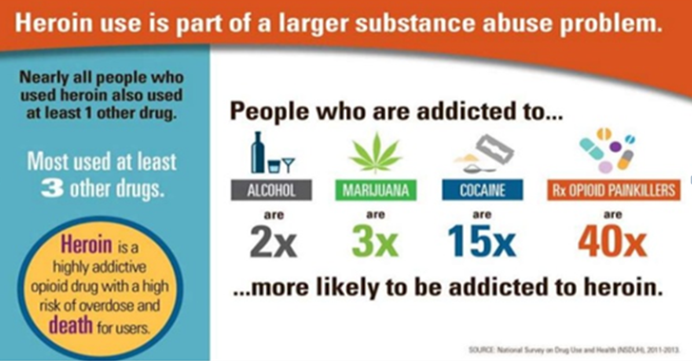

Slide 5
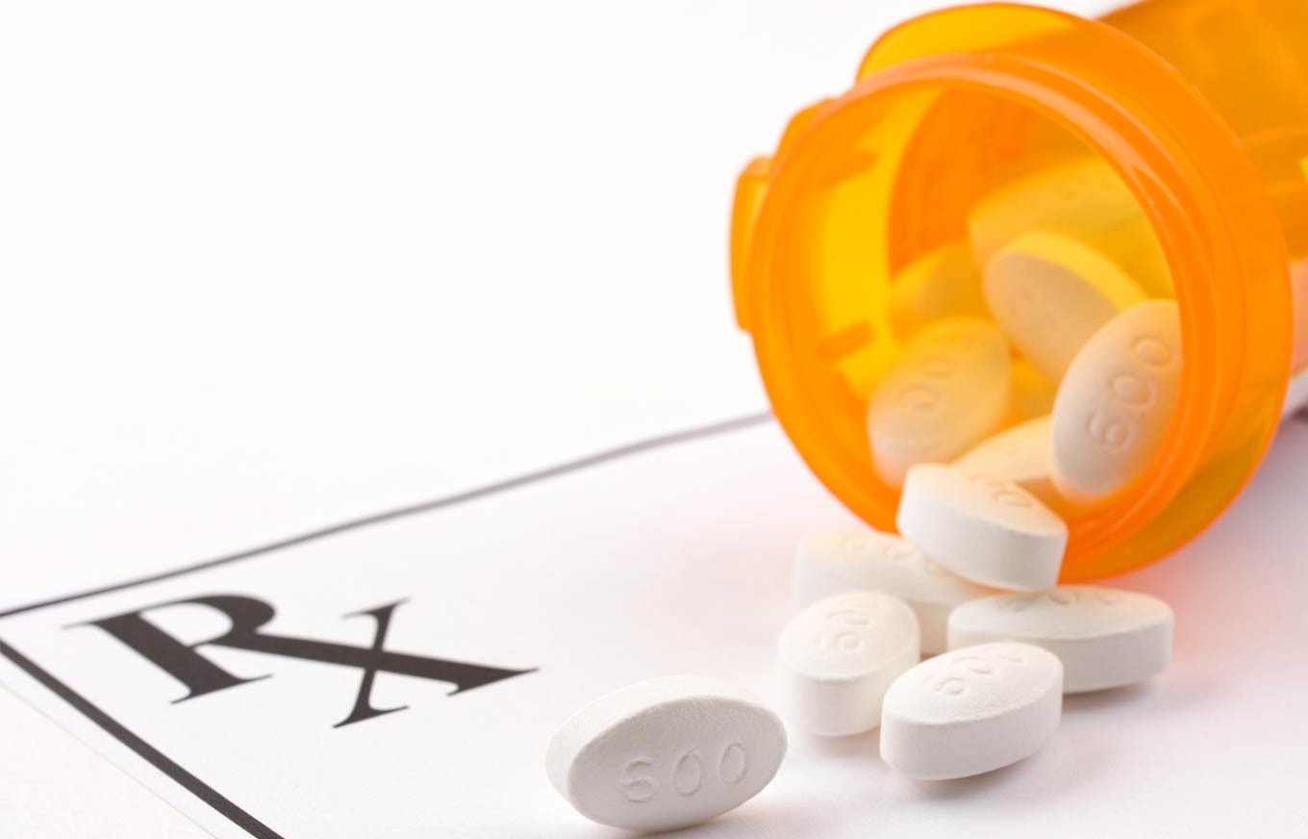
Prescription Medication
___________________________________________________________________________________________________________________________________________________________________________________________________________
The United States makes up about 5 percent of the world's population, but consumes 80 percent of its opioids -- and 99 percent of the world's hydrocodone, the opiate that is in Vicodin.
1 in 30 high school students abused OxyContin (Oxycodone) at least once.
You can’t maintain an opiate addiction and a normal life for very long.

Slide 6
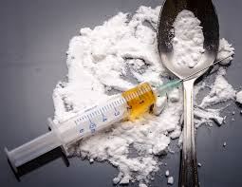
Heroin
___________________________________________________________________________________________________________________________________________________________________________________________________________
Taking heroin is just like taking any other painkiller.
Overdosing on heroin is easy to do.
Never have any idea what is mixed with the heroin.
After a heroin overdose, everyone wants to get their hands on that heroin because it is potent.
75% of subjects that try heroin once use it again.

Slide 7
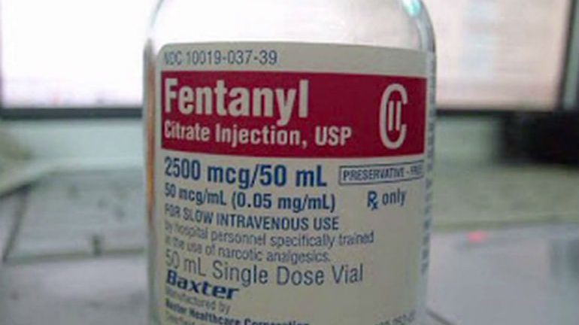
Fentanyl
___________________________________________________________________________________________________________________________________________________________________________________________________________
Synthetic opiate similar to morphine and can be legally prescribed by a doctor.
Chronic pain patients are mostly prescribed.
Can be 40-50 times more powerful than heroin
Can be absorbed through the skin(patches), injected, or inhaled.

Slide 8
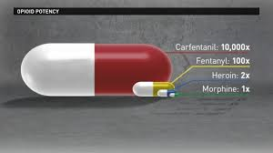
Carfentanil
___________________________________________________________________________________________________________________________________________________________________________________________________________
100 times more potent than fentanyl.
Analogue of the synthetic opioid analgesic fentanyl.
Used as a tranquilizing agent for elephants and larger mammals.
Not approved for human use.
Often disguised as heroin.
Improper handling of carfentanil, as well as fentanyl, can be life threatening.

Slide 9
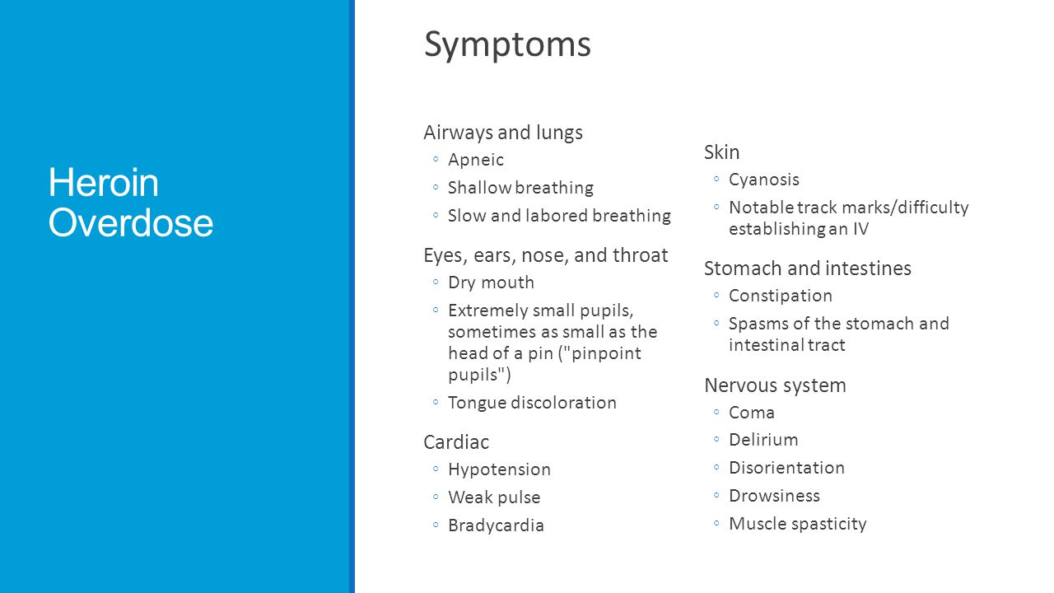

Slide 10
