Slide 1
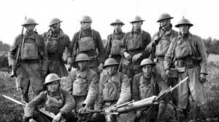
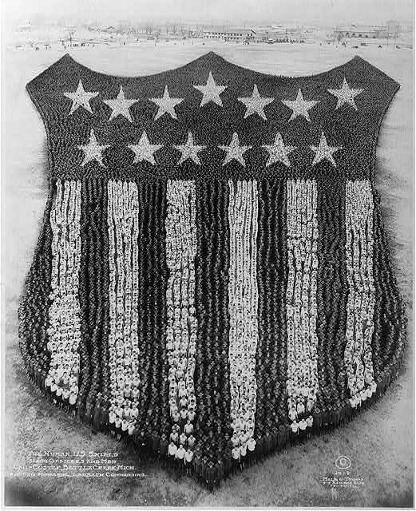
SOUTH MILWAUKEE
WORLD WAR I
DEAD

Slide 2
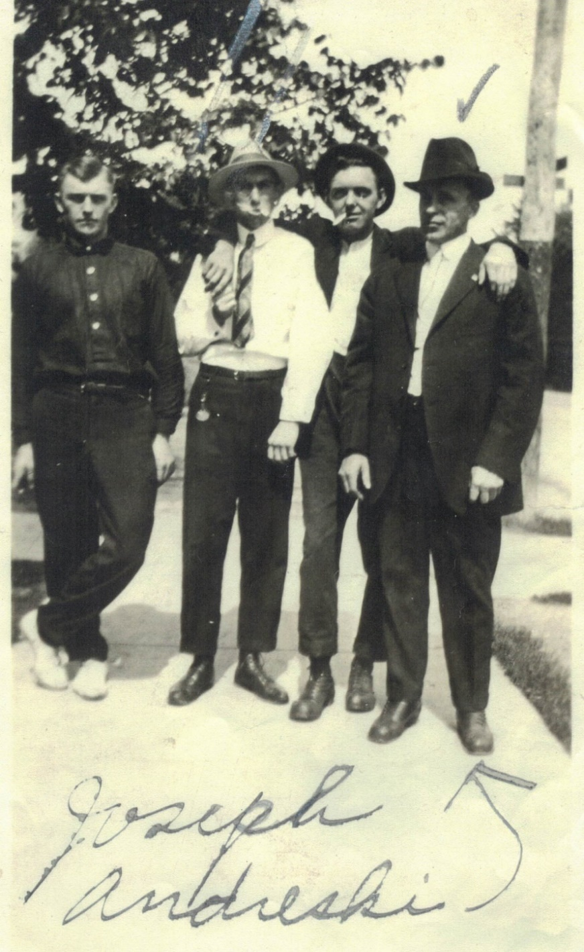
PRIVATE JOSEPH ANDRESKI
Born 1888 in Poland, Had only one relative, a cousin in the US in Beaver Falls PA. named Anton Sydlik.
Lived at 1300 Milwaukee, Ave.
Attend St. Adalbert's school until 3rd grade.
Worked as a Laborer at Bucyrus.
Drafted into the US Army April 26,1918.
Assigned to Company F, 4 Infantry Regiment, 3rd Infantry Division.
KIA on October 10, 1918 Age 30.
Body never recovered but records indicate that he is believed to have been buried as a Unknown

Slide 3
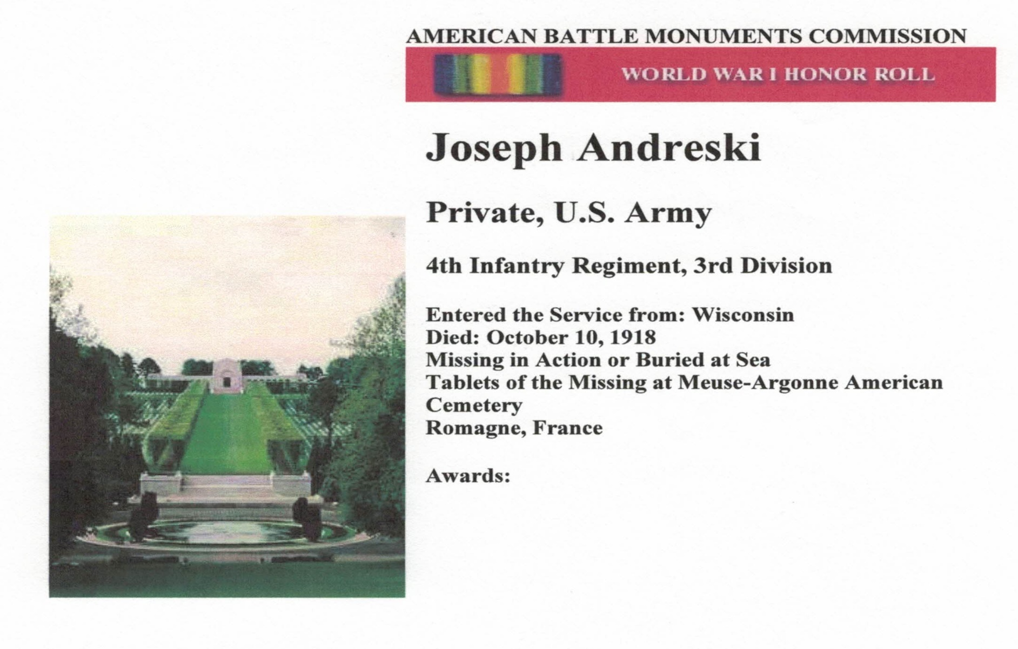
TABLETS OF THE MISSING
MEUSE-ARGONNE CEMETERY
FRANCE

Slide 4
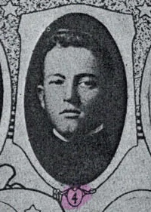
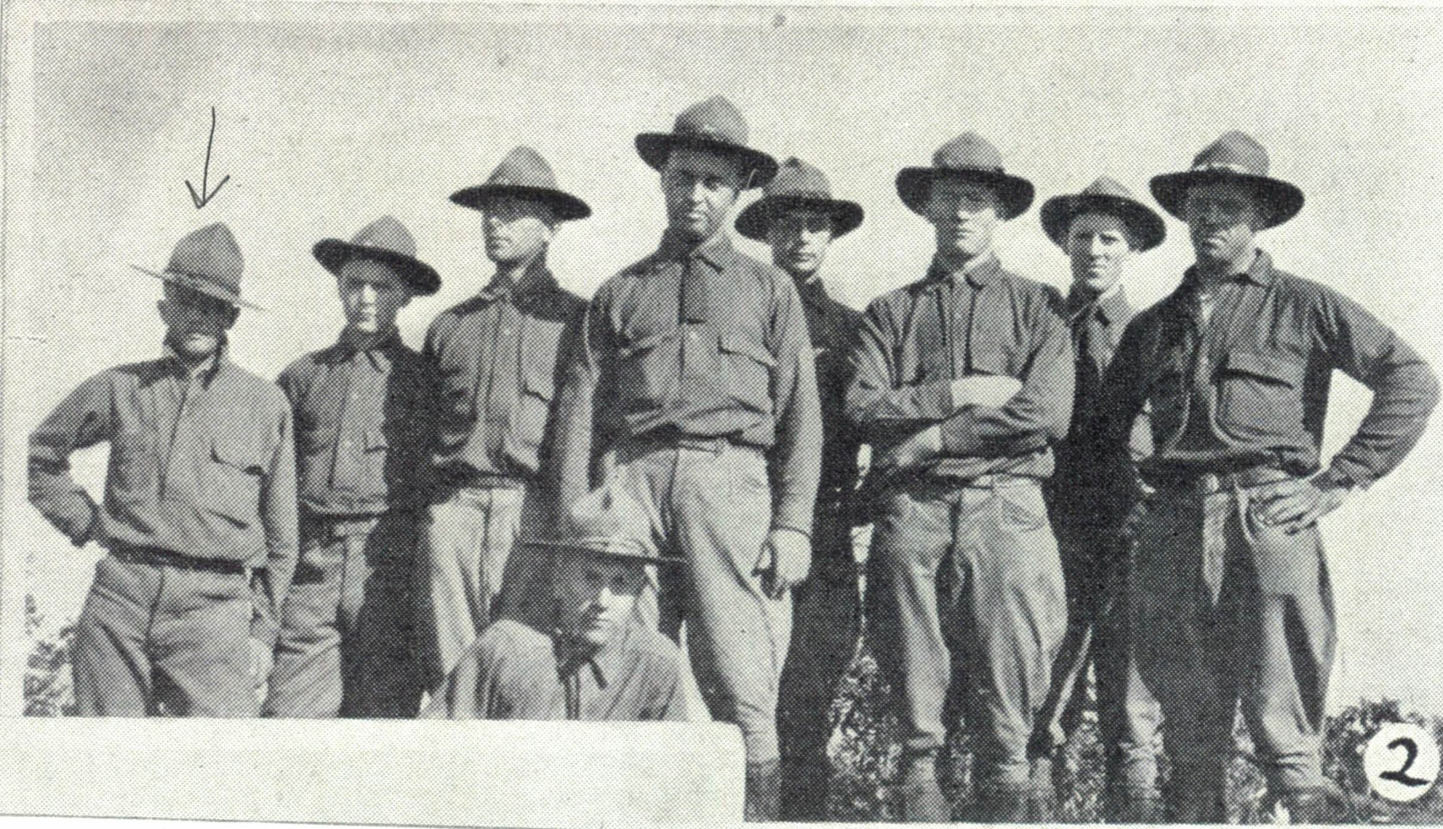
CORPORAL HAROLD F. BISSONETTE

Slide 5
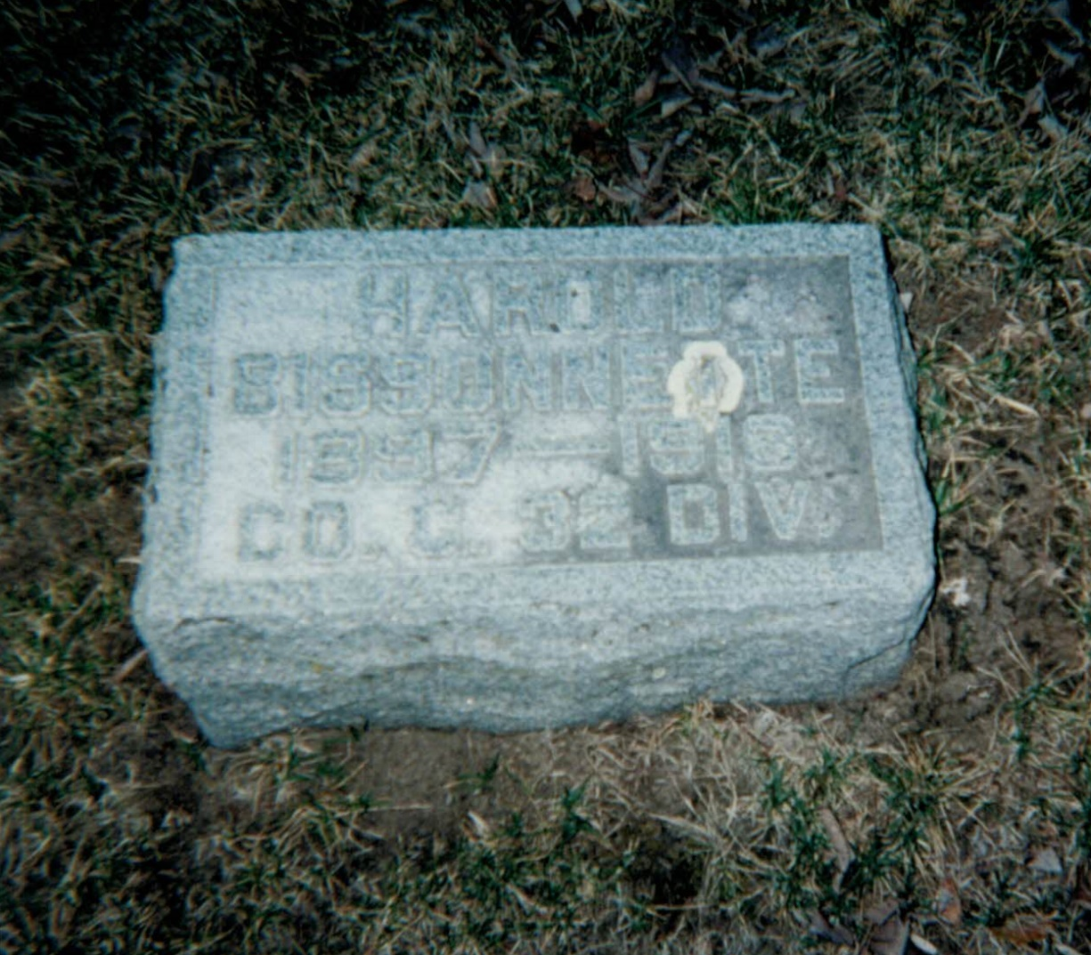
BURIED IN IMMACULATE CONCEPTION CEMETERY, CHARLES CITY, IOWA
Born January 7, 1896 in Iowa.
Date on Enlistment unknown.
Assigned to Battery C, 120th Field Artillery, 32nd Division.
Unit was sent to the port of embarkation.
Admitted to St. Mary’s Hospital in Hoboken, N.J. on February 25, 1918.
Died at the hospital on April 26, 1918 of Pneumonia and Measles. Age 22
Remains shipped home.

Slide 6
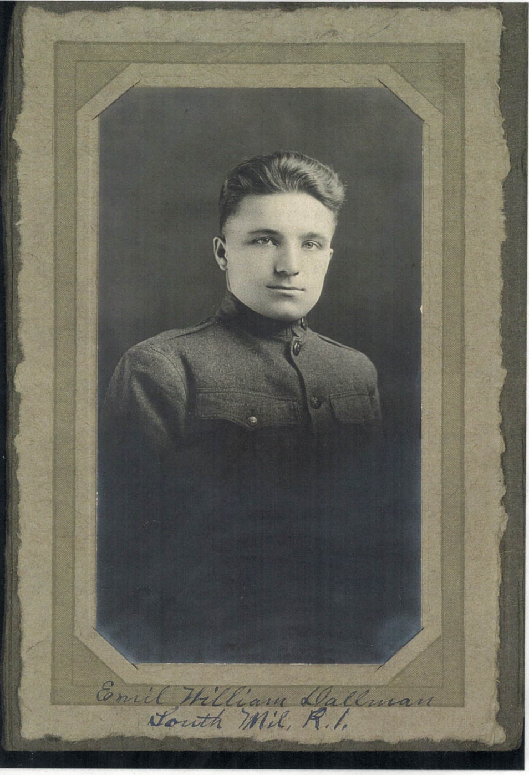
SERGEANT eMIL DALLMAN
Born March 20, 1896.
Lived at Rural Route #1 Oakwood Road, South Milwaukee Post Office.
Enlisted at Milwaukee in July 1917
September 22, 1917 Sent to Camp Custer, MI.
Transferred to Camp Green, NC on March 3, 1918.
Assigned to Company H, 39th Infantry Regiment, 4th Infantry Division.
Participated in Action at Norroy, St. Thibault and the
Muese-Argonne offensives.
KIA October 14, 1918. Age 22.
Body disinterred September 29, 1921 and shipped home. Family received him on December 29, 1921.
When Oak Creek American Legion Post 434 Formed after WW II they selected Sgt. Dallman’s names as one of their namesakes.

Slide 7
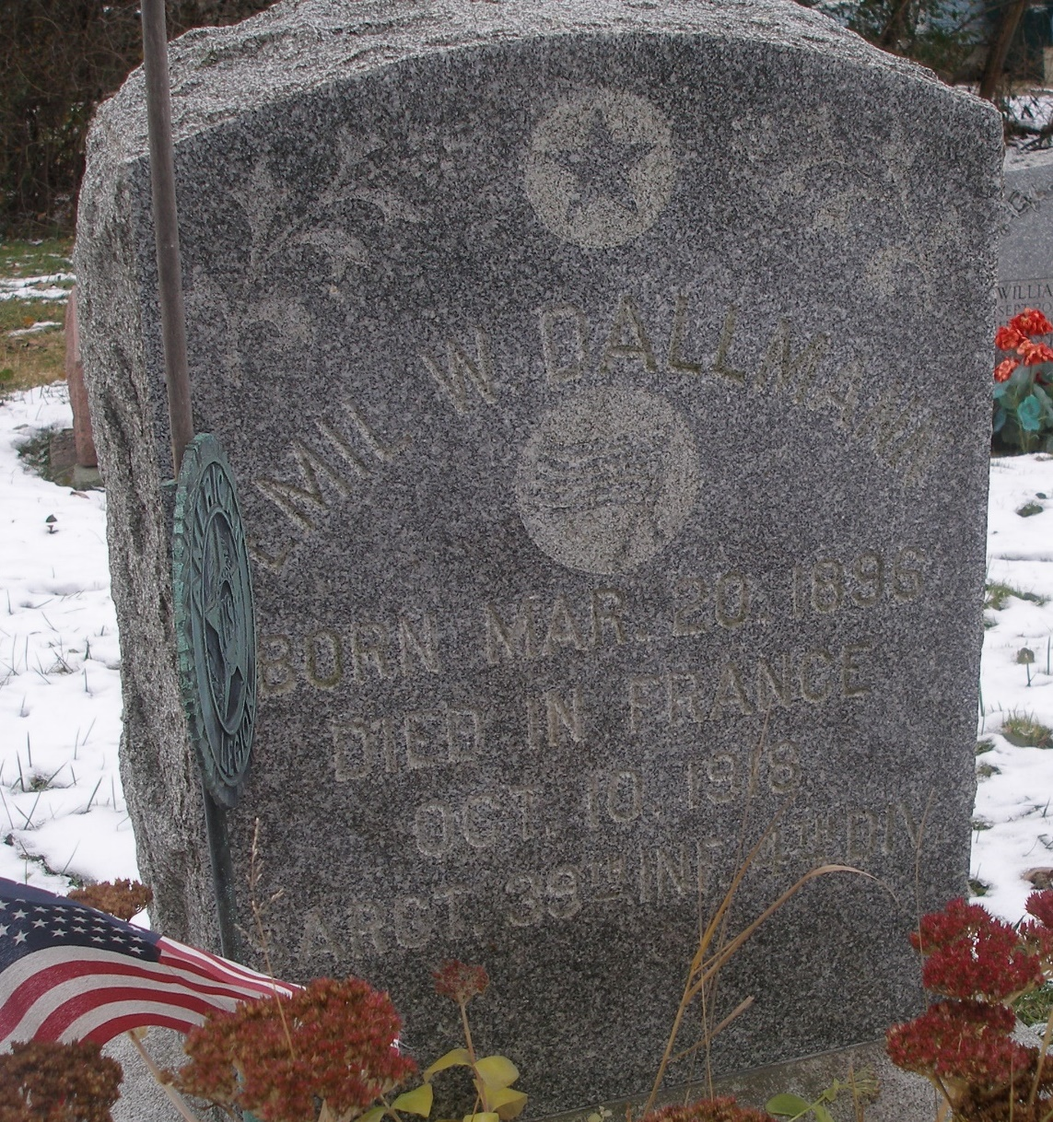
BURIED IN OAKWOOD REST CEMETERY
OAK CREEK

Slide 8
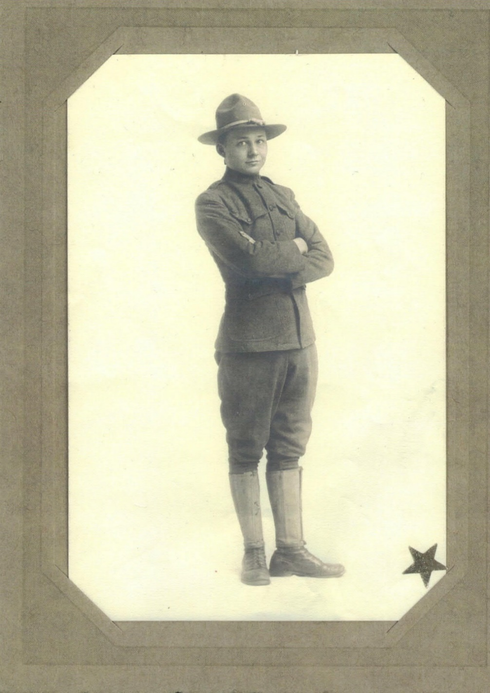
PRIVATE WILLIAM JOERG
Born June 20, 1897
Lived at 1216 Michigan Ave. So. Milwaukee.
Had some formal training possibly college and worked as a machinist at Bucyrus.
Enlisted April 1917. Assigned to Company E, 128th Infantry, 32nd Division.
Wounded October 11, 1918, gun shot wound to femur.
Died at Paris Military Hospital 85 on February 3, 1919, Due to hemorrhage, and disorder of the heart. Age 21.
Family request burial at Arlington National Cemetery. Funeral took place there on October 8, 1920.

Slide 9
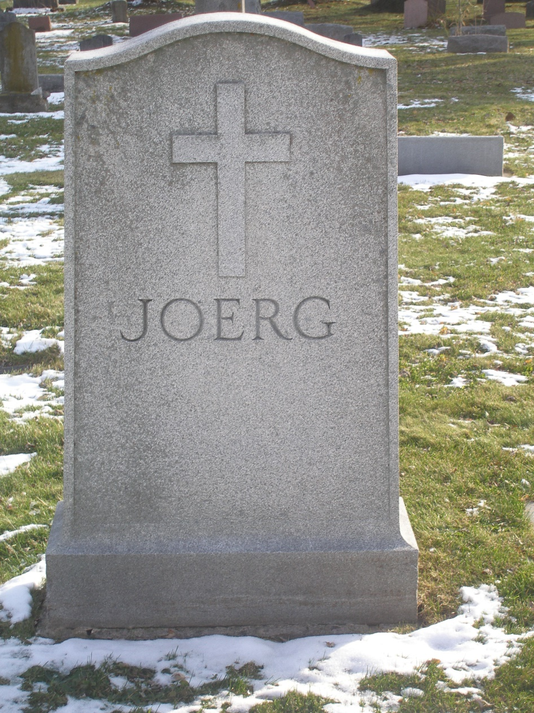
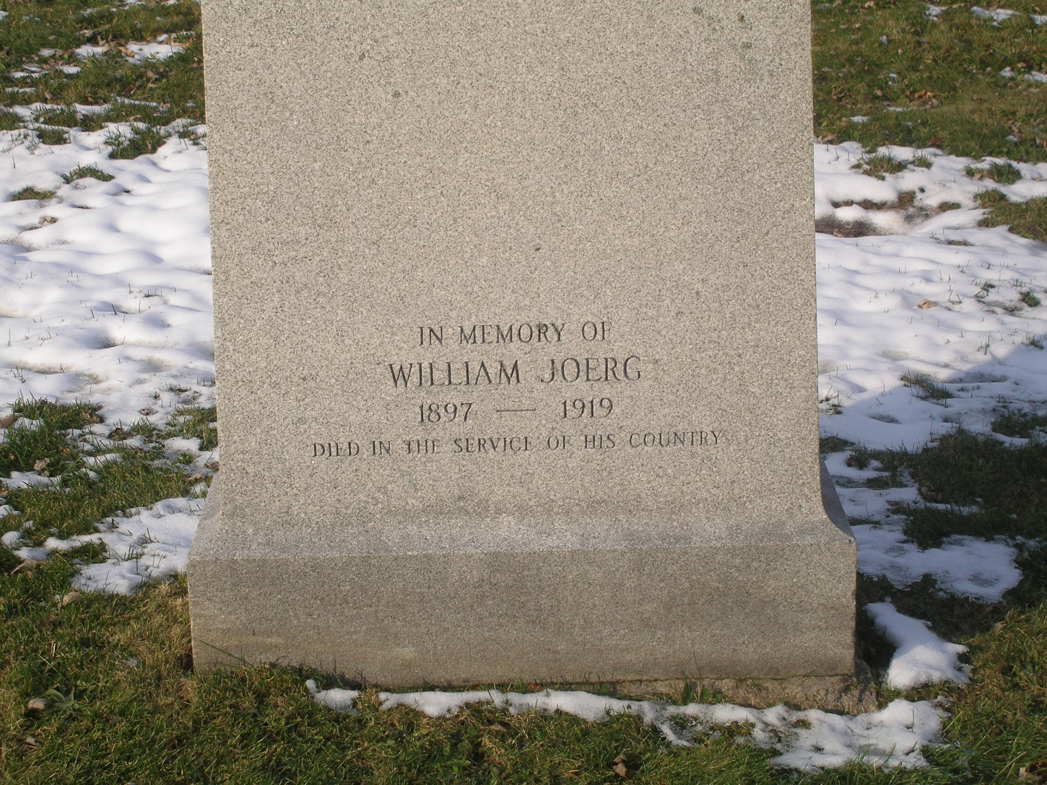
CENOTAPH ST. JOSEPH CEMETERY
OAK CREEK

Slide 10
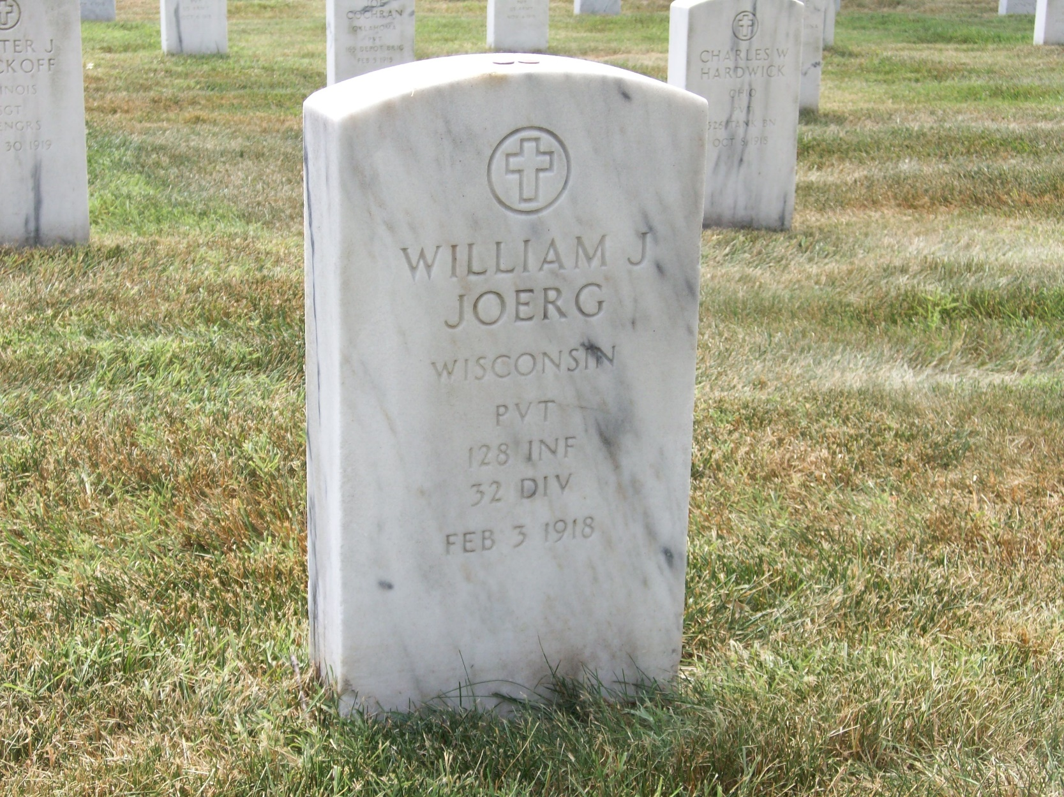
BURIED AT ARLINGTON NATIONAL CEMETERY WASHINGTON, D.C.

Slide 11
PRIVATE JOHN KOBUS
Born In Poland / Russia, May 1, 1892.
Lived at 1411, later 1429 Missouri Ave. So. Milwaukee.
Attend St. Adalbert’s church, worked as a laborer at Badger.
Enlisted In the US Army on September 21, 1917, Assigned to Company B, 58th Infantry regiment, 4th Infantry Division.
Was killed when the Troop Ship Moldavia was torpedoed by a German submarine at 2 am on May 23, 1918. Age 26.
The torpedo hit the berthing compartment of Company B and 56 men were lost.
The Moldavia sunk however the rest of the regiment and crew were saved.
We have not found a picture of John Kobus.

Slide 12
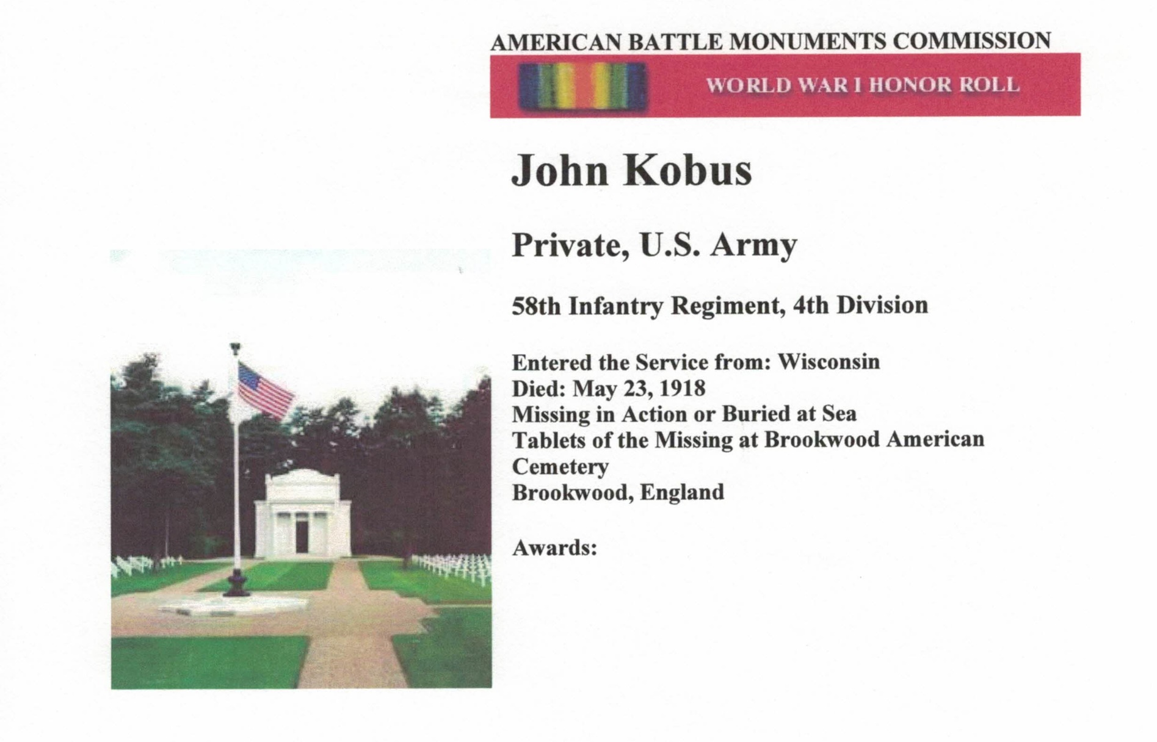
TABLETS OF THE MISSING BROOKWOOD CEMETERY, ENGLAND

Slide 13
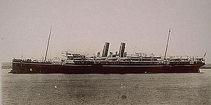
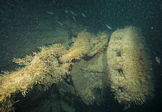
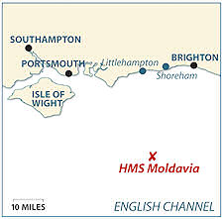
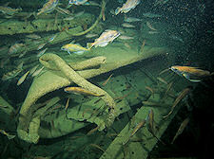
LOST AT SEA IN THE ENGLISH CHANNEL ABOARD THE TROOP SHIP MOLDAVIA

Slide 14
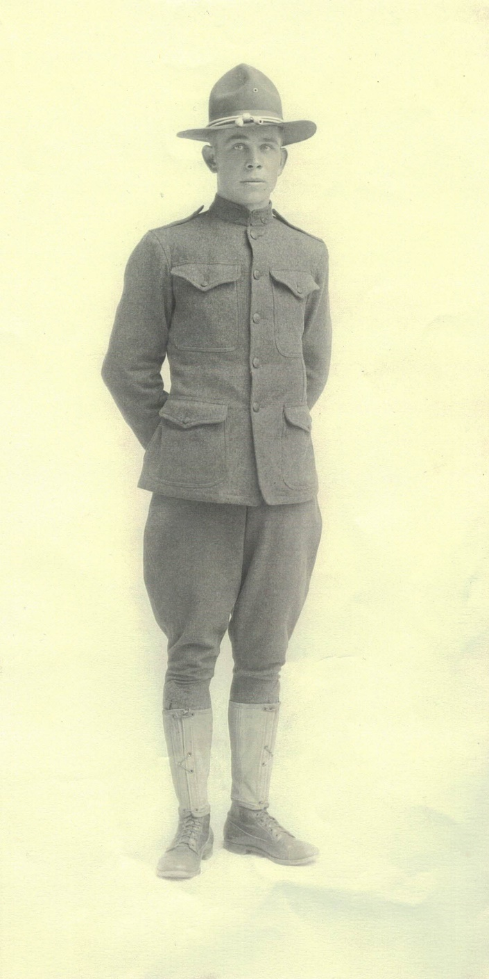
PRIVATE JOSEPH LESZKIEWICZ
Born in South Milwaukee in1896.
Lived at 1622 Rawson Ave. Later Mother Helen would move to 501 Madison Ave, South Milwaukee.
Completed 5th grade. Attended the Polish National church.
Enlisted March 21, 1917 in Company D, 127th Infantry, Wisconsin National Guard. Would be assigned as part of the 32nd Division.
Fought at Chateau Thiery, Fismes and Soissoins
KIA August 30, 1918. Age 22
In his honor his mother donated $200 for a Liberty Loan purchase.
Disinterred May 24, 1921. Arrive South Milwaukee, July 29, 1921. Buried at Polish National Cemetery (now called Chapel Hill) August 31, 1921

Slide 15
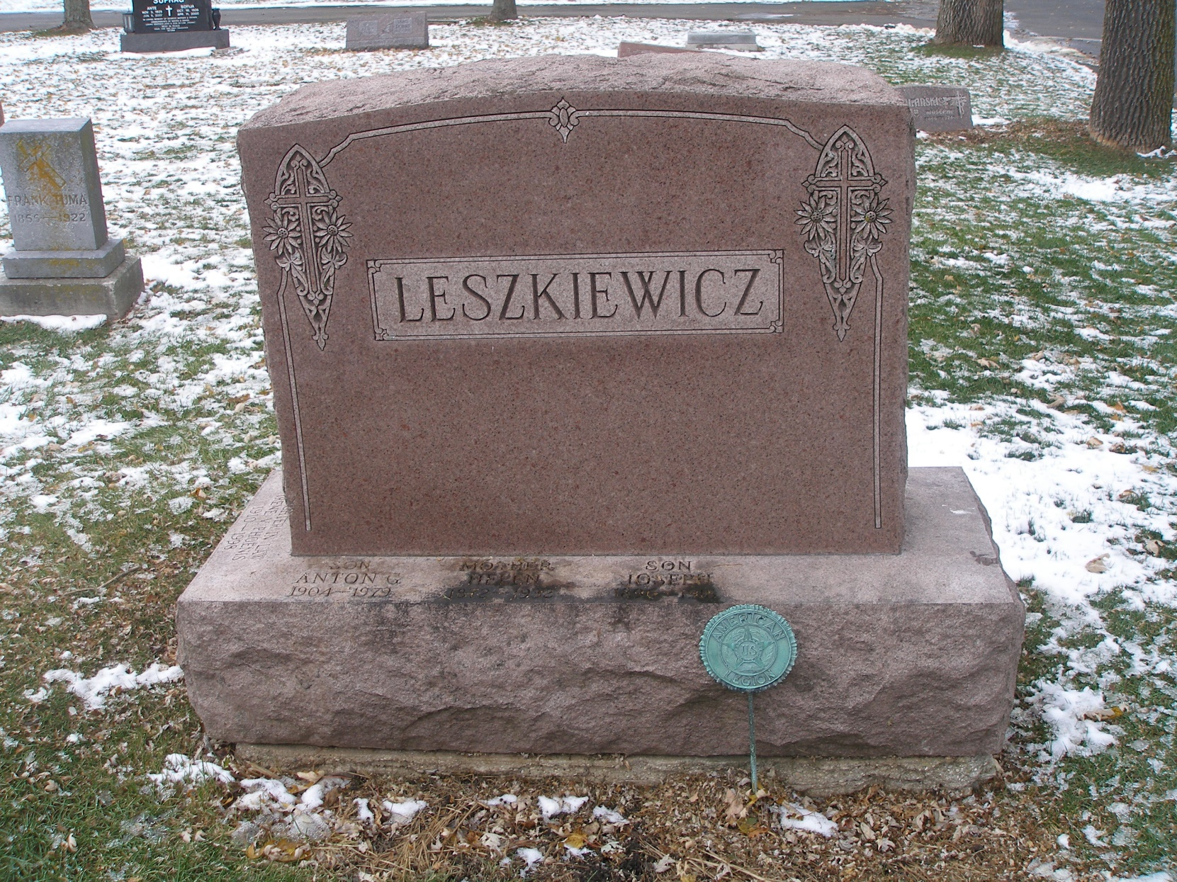
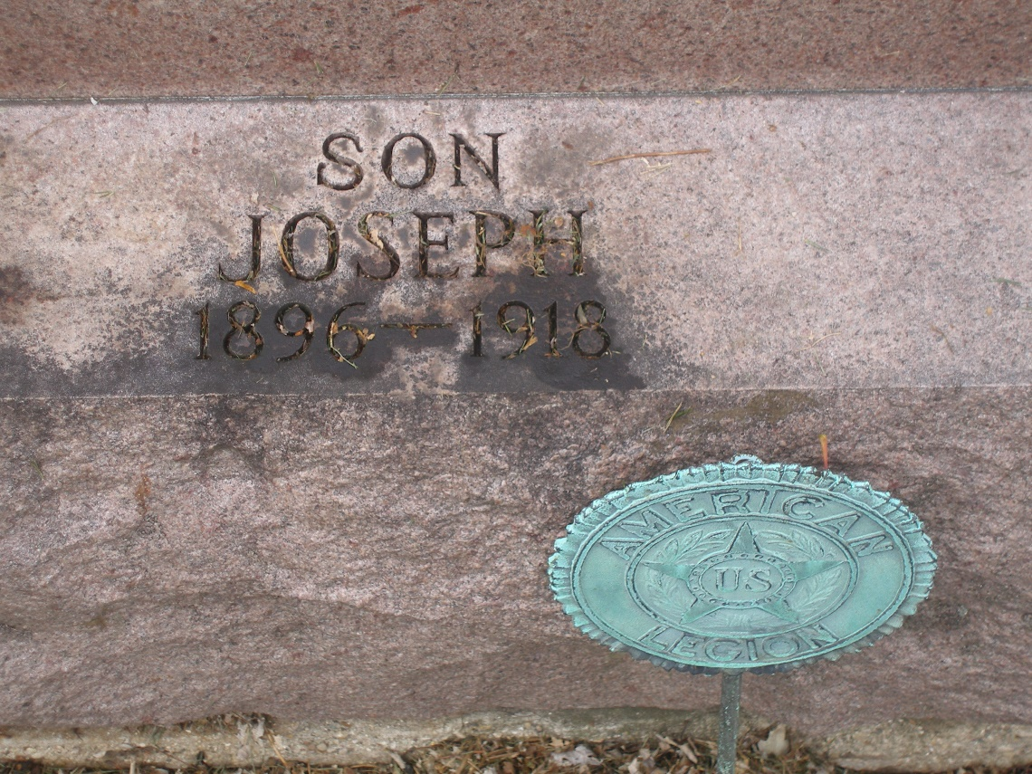
Buried in chapel hill cemetery, greenfield

Slide 16
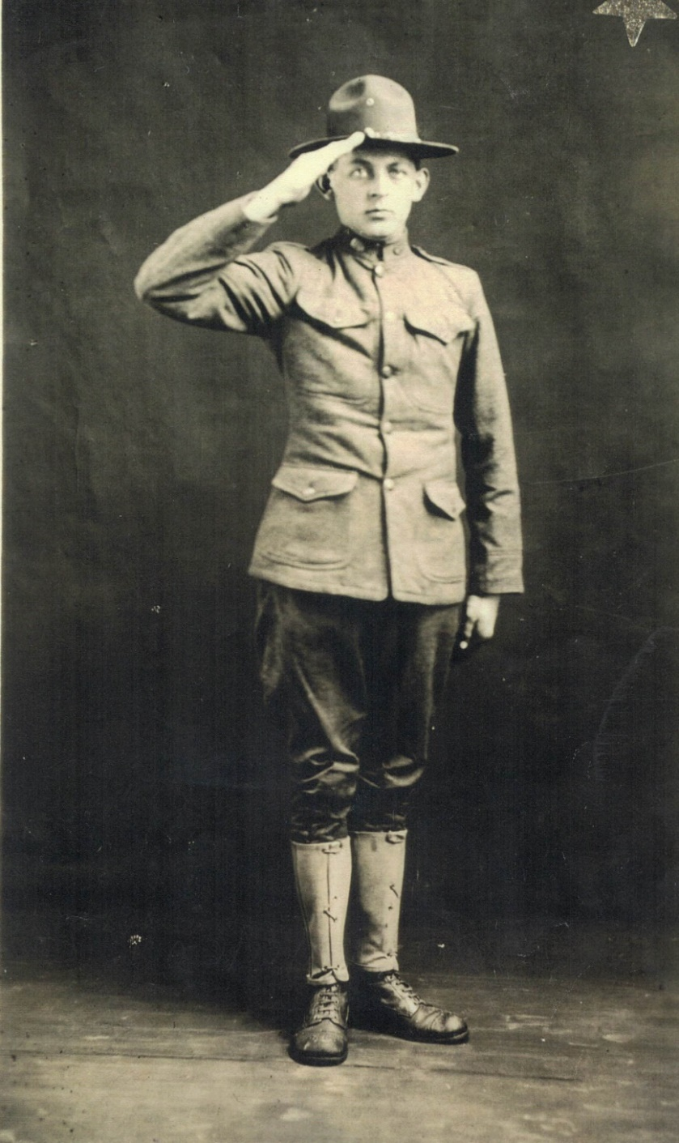
PRIVATE JOHN LIBECKI
Born April 8,1894.
Lived at 1232 Minnesota Ave. South Milwaukee.
Attended St. Adalbert’s grade school.
Occupation was a car maker at Bucyrus.
Entered service November 18, 1917.
Assigned to Company G, 47th Infantry Regiment, 4th Infantry Division as a Wagoneer.
KIA September 27, 1918, Poison Gas. Age 24.
Remains returned home on November 10, 1921. Funeral from St. Adalbert’s was on November 15, 1921.

Slide 17
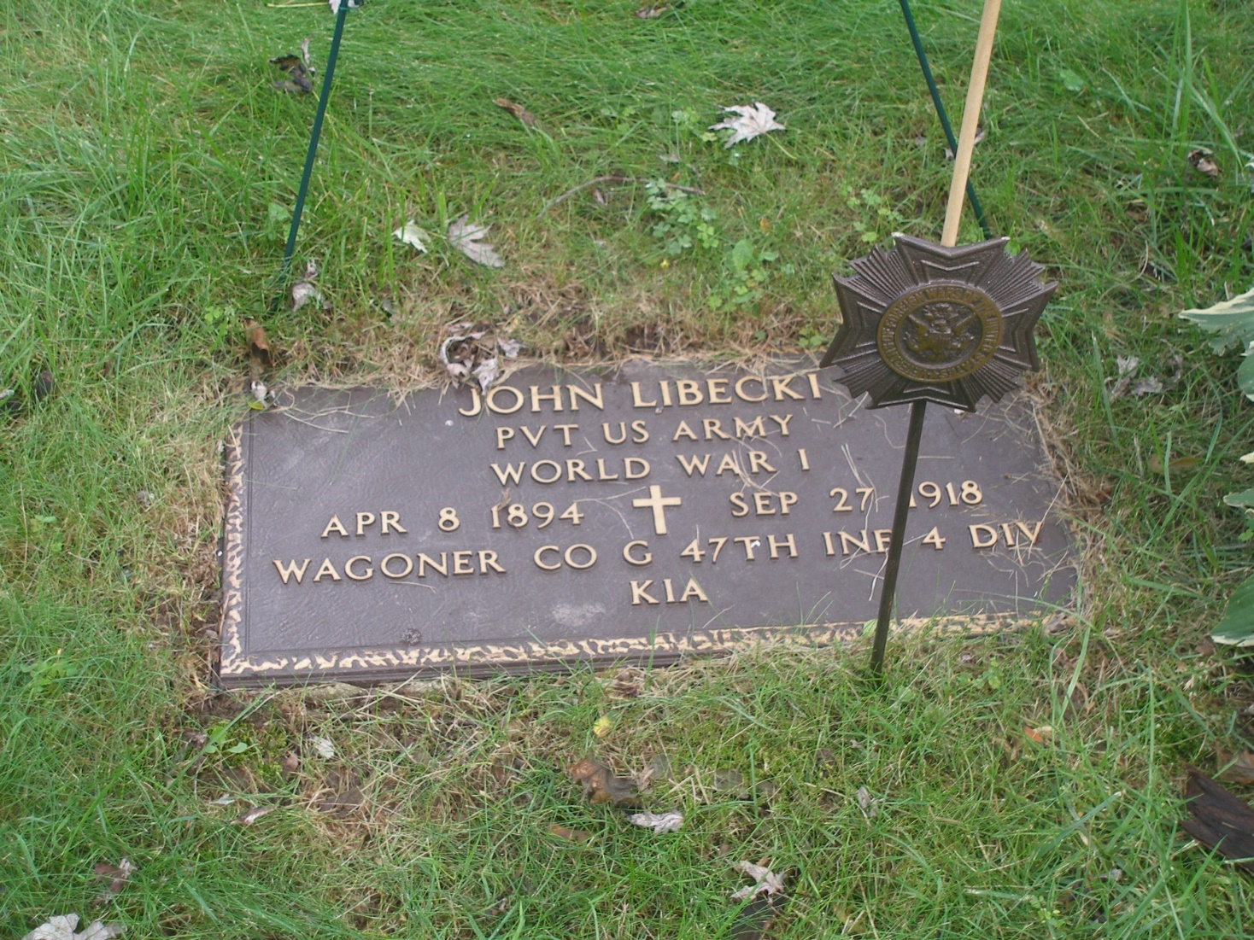
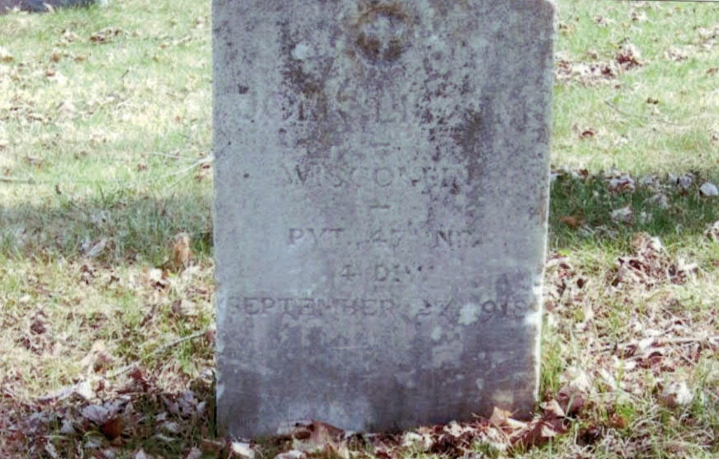
BURIED AT HOLY Sepulcher CEMETERY CUDAHY

Slide 18
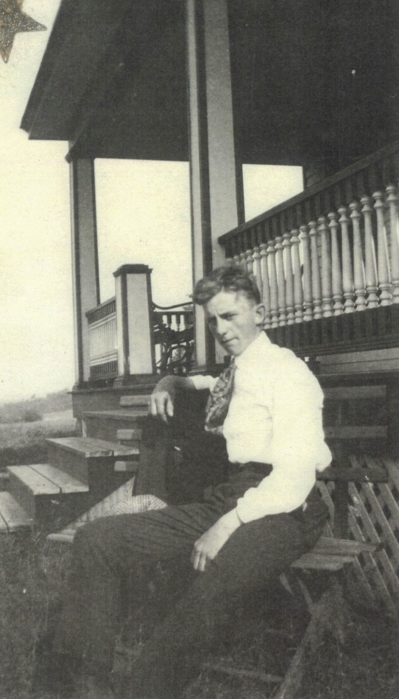
Seaman
RAYMOND L. MALNORY
Born November 11, 1899 in Carrollville, Oak Creek.
Lived at 907 Michigan Ave South Milwaukee.
Completed 8th Grade and worked as a farmer.
Enlisted in the US Navy in Detroit July 13, 1918.
Mother was living in Lake Ann, MI.
Died of pneumonia at the at the US Navy Rifle Range Camp Logan IL. October 8, 1918. Age 18.

Slide 19
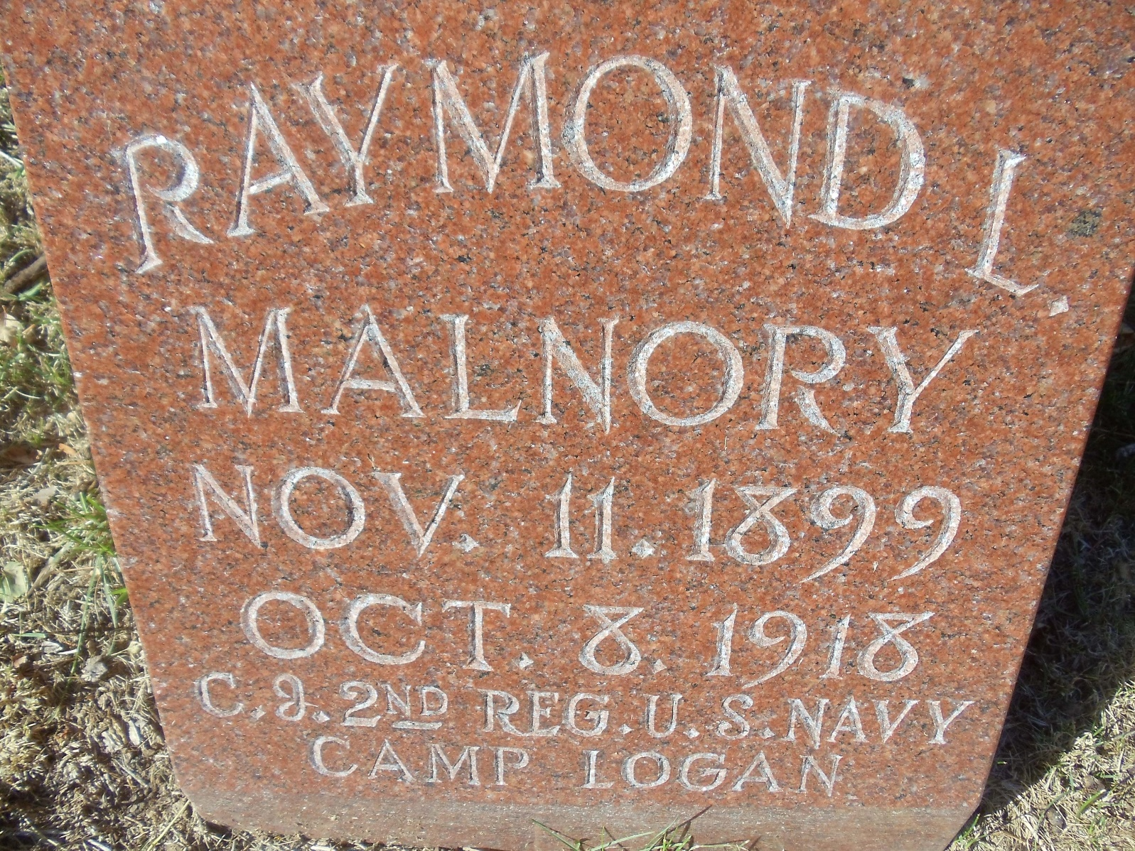
BURIED AT GOOD HOPE CEMETERY MILWAUKEE

Slide 20
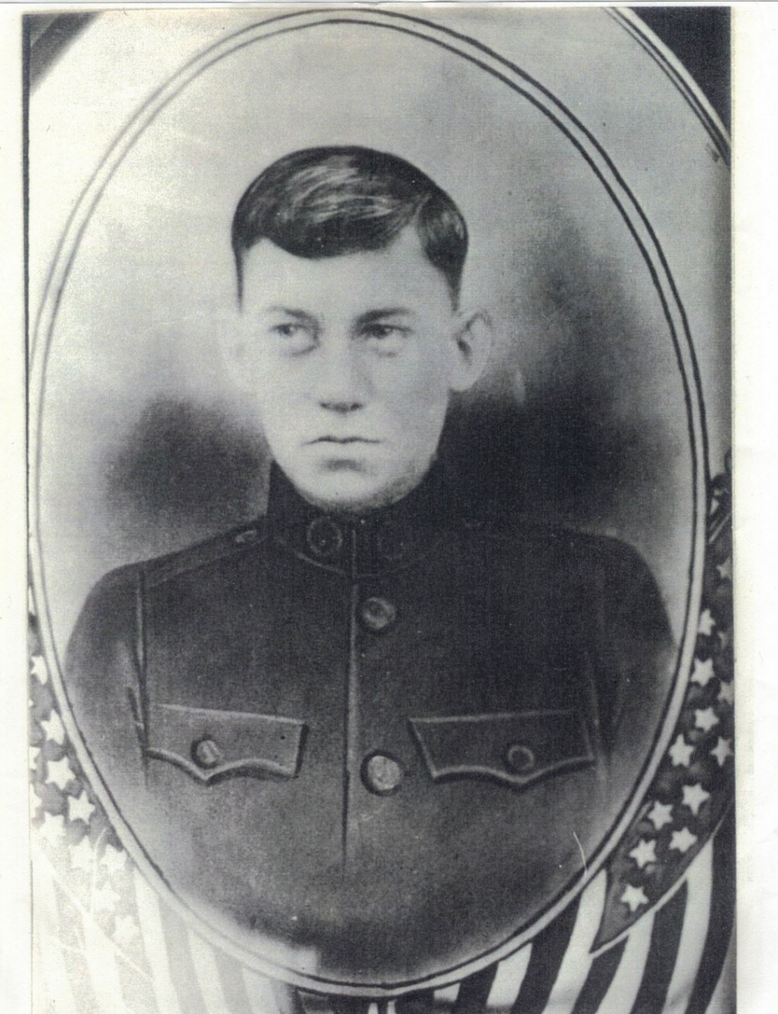
PRIVATE
MAURICE C. J. O’BRIEN
Born January 6, 1901.
Lived at 805 Michigan Ave. South Milwaukee.
Had two years of High School.
Entered service at age 16 in July 1917.
Assigned to Company F, 127th Infantry, 32nd Division.
Fought at Chateau Thiery, and Cierges.
KIA by shrapnel on August 21, 1918. Age 17.
Body Returned home on July 29, 1921.
Funeral from St. John’s church on August 1, 1921.

Slide 21
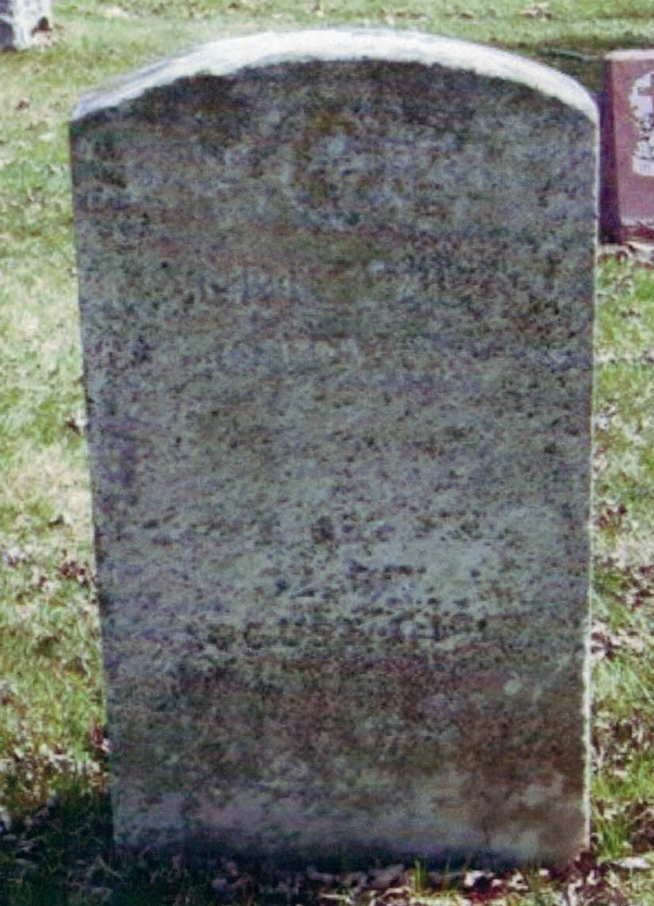
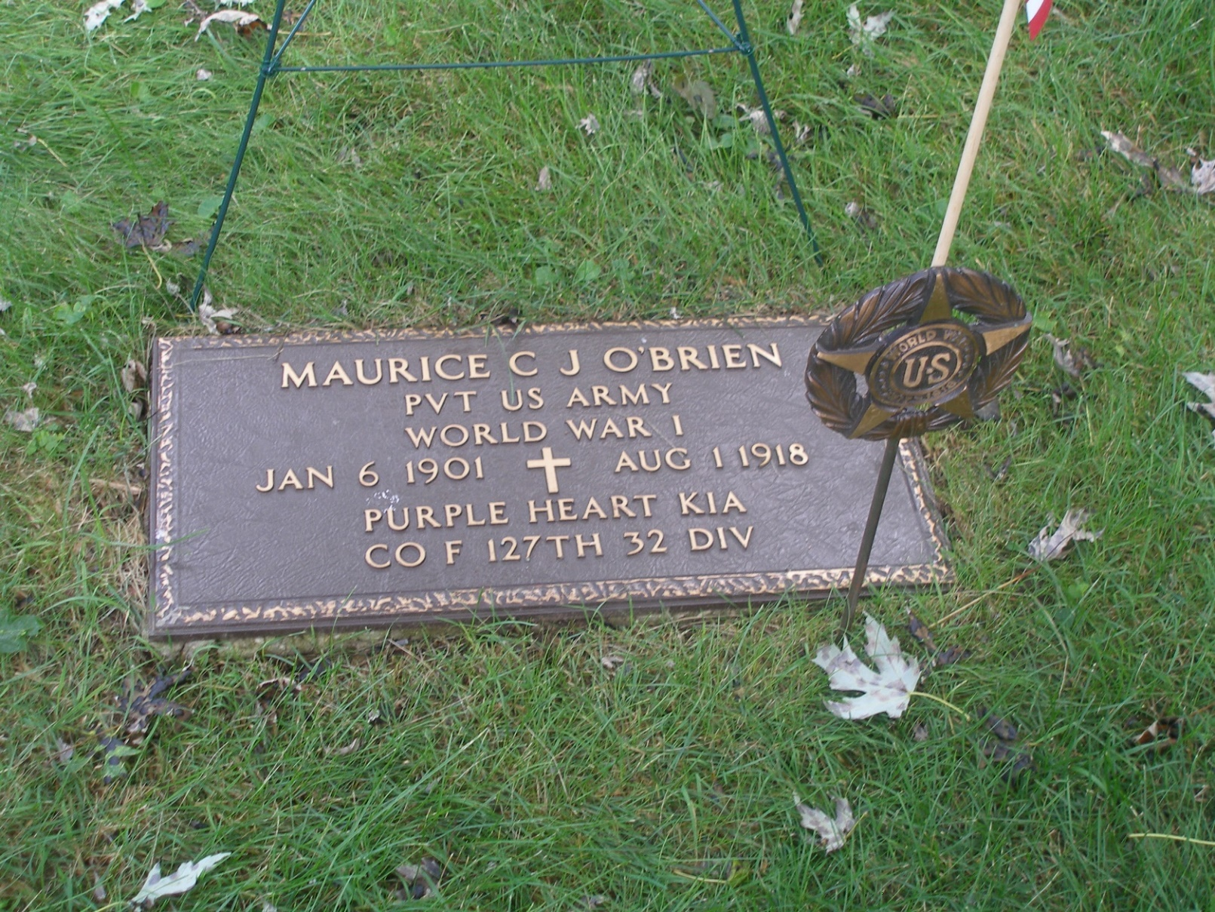
BURIED At HOLY Sepulcher cemetery cudahy

Slide 22
Pfc VINTON j. MOORE
Born 1898.
Lived in Ladysmith, WI came to work at Bucyrus.
Parent lived in Minnesota.
Enlisted on March 31. Not clear if it was in 1917.
Assigned to Company F, 17th Infantry Regiment, 32nd Division.
Not sure of rank, found him listed as Corporal and later as PFC.
KIA July 30, 1918, Machine gun fire to the head. Age 20.
We have no picture on PFC Moore.

Slide 23
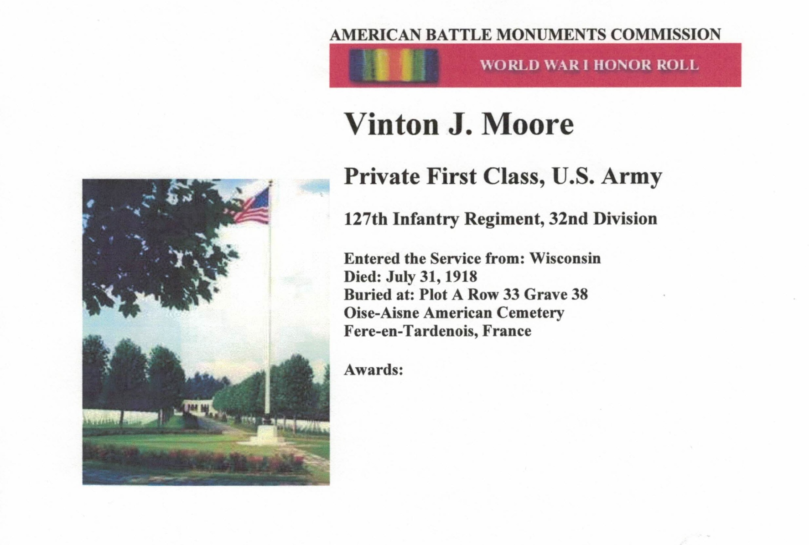
BURIED IN OISE-AIsNE CEMETERY
FRANCE

Slide 24
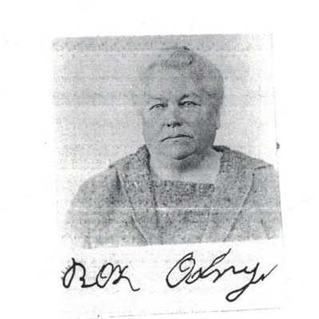
PRIVATE EDWARD ODRY
Born 1898
Lived at 1421 Menomonee Ave, South Milwaukee.
After the war the family would move to Trenton, NJ.
Edward enlisted in the USMC May 19, 1917.
Assigned to 80th Company, 6th Marine Regiment, 2nd Army Division.
KIA October 7, 1918, Gun Shot Wound near Blanc Mont Champagne. Age 20.
Mother Rose attended the 1930 Mother’s pilgrimage to visit her sons grave in France.
We have no picture of Private Odry.

Slide 25
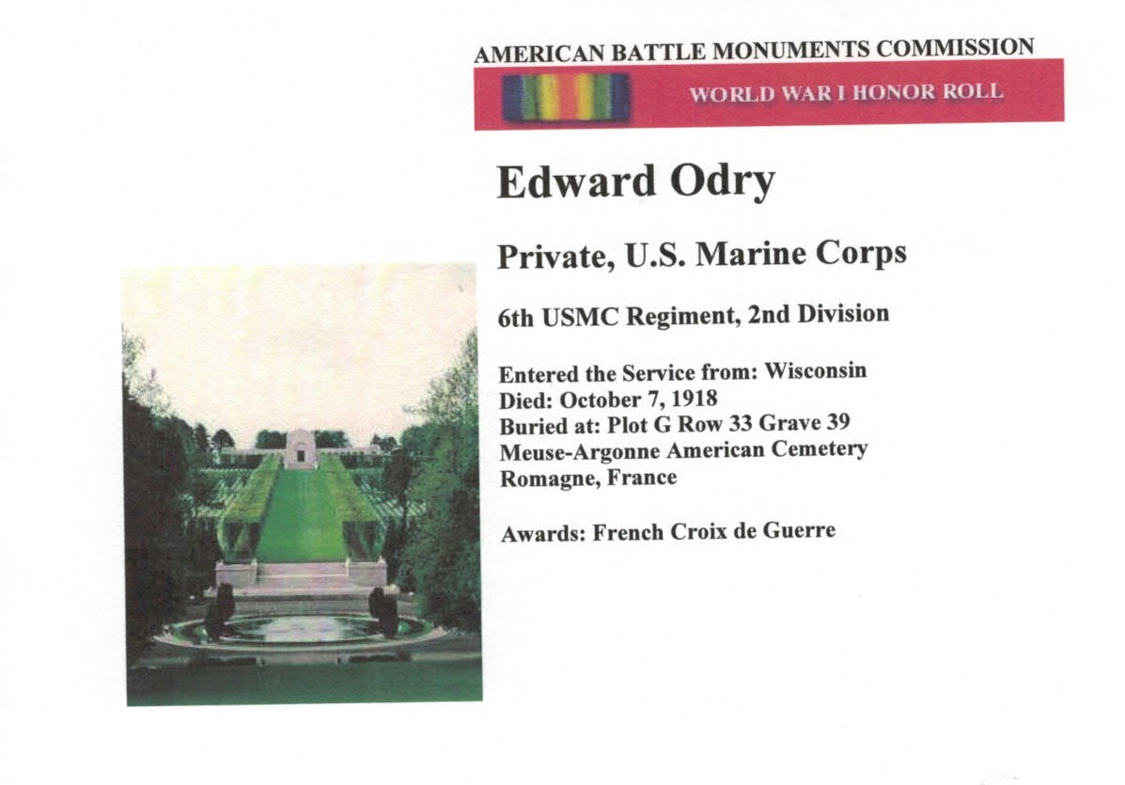
BURIED IN THE MEUSE-ARGONNE CEMETERY, FRANCE

Slide 26
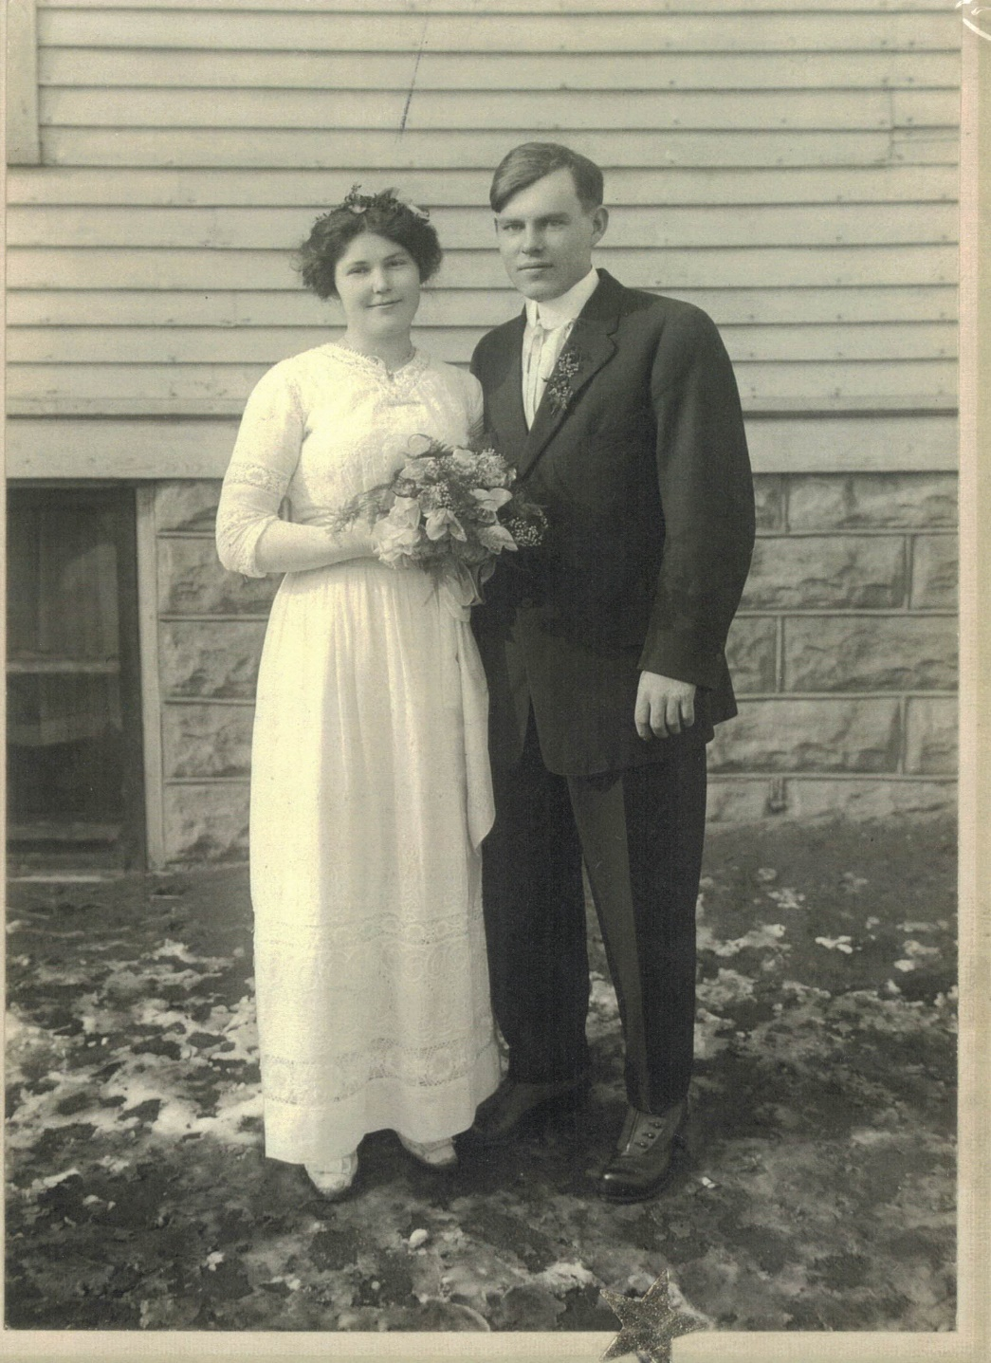
PRIVATE AUGUST RADOMSKI
Born May 5, 1896.
Lived at 1435 Missouri Avenue, South Milwaukee.
Attended Sts. Peter & Paul National Catholic Church.
Completed 7th grade.
Worked as a machinist at Bucyrus.
Entered US Army September 20, 1917.
Assigned to 407th Aero Construction Squadron, 1st Provisional Regiment, Spruce Production Division Bureau of Aircraft Production.
Sent to Camp Custer MI and then to Fort Vancouver, Washington.
Died at Ft. Vancouver Barracks of tuberculosis on June 28, 1918. Age 22.
Buried at Ft. Vancouver.

Slide 27
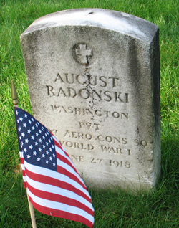
BURIED AT FT. VANCOUVER CEMETERY
WASHINGTON

Slide 28
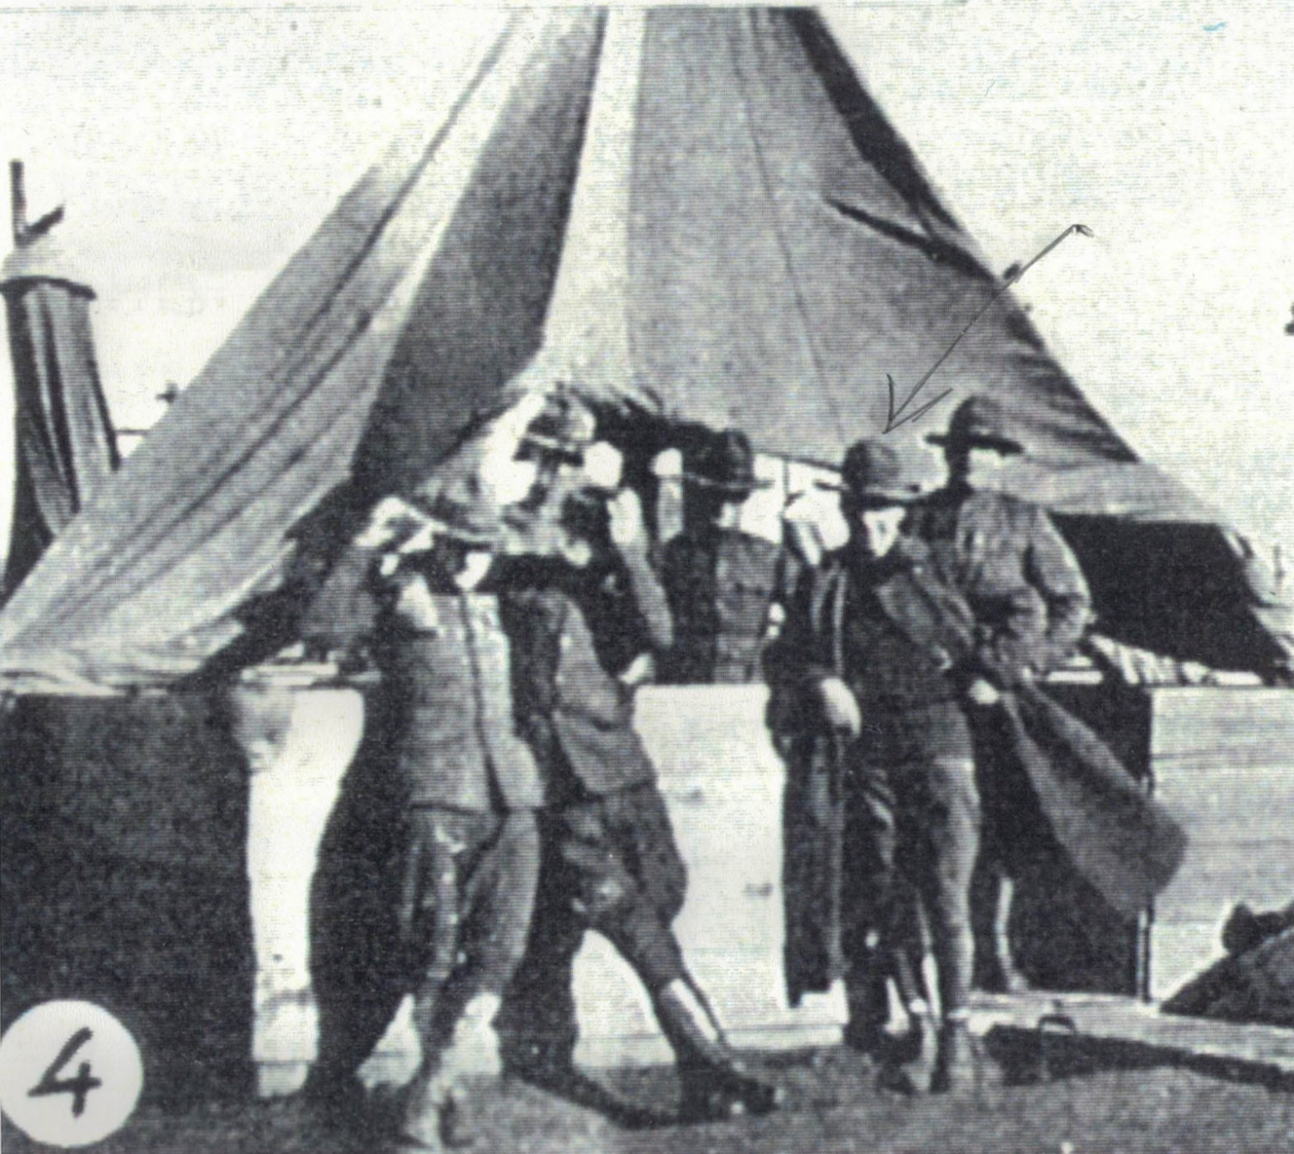
PRIVATE ARTHUR C. RYAN
Born in Chicago, IL, February 23, 1897.
Worked at Bucyrus as a draftsman.
Lived at 1008 ½ Milwaukee, Ave. South Milwaukee. Member of St. John’s Church.
Enlisted on July 28, 1917.
Assigned to Battery C, 120th Field Artillery, 32nd Division.
Killed by explosion of French 75 artillery piece along with Everheart Van Eimeren and Alonzo Cudworth (American Legion Post 23 name sake.) Age 21.
Explosion occurred at 5:20 am on August 29th, 1918 during the battle of Juvigny France.
Disinterred October 28, 1920. Received in St. Louis on January 1, 1921.
Mother’s Thank You note to escort is in file.

Slide 29
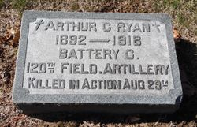
BURIED IN CALVARY CEMETERY
ST. LOUIS, MISSOURI

Slide 30
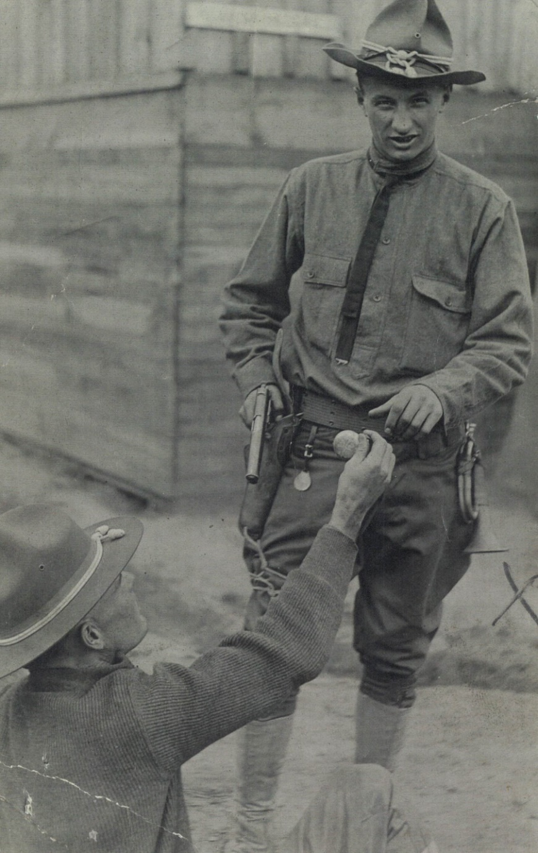
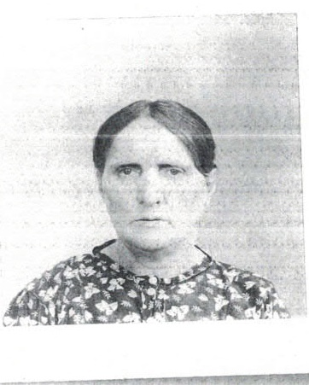
Bugler
MICHAEL SLOMKA
Born 1898 in South Chicago, IL.
Lived at 1101 15th Avenue South Milwaukee.
Entered Service January 23, 1917
Assigned to Company D, 11 Infantry, 5th Division.
KIA November 8, 1918. Age 20. Last seen on November 5 advancing with the company against machine gun and artillery fire.
Mother, Augusta, made Gold Star Mother’s Pilgrimage in 1932. She could only speak Polish and could not read or write. There was an interpreter assigned to her. Father was refused the Pilgrimage because the Congressional Act of 1929 that established the program was only for Widows or Gold Star Mother’s of deceased service members.
Augusta Slomka

Slide 31
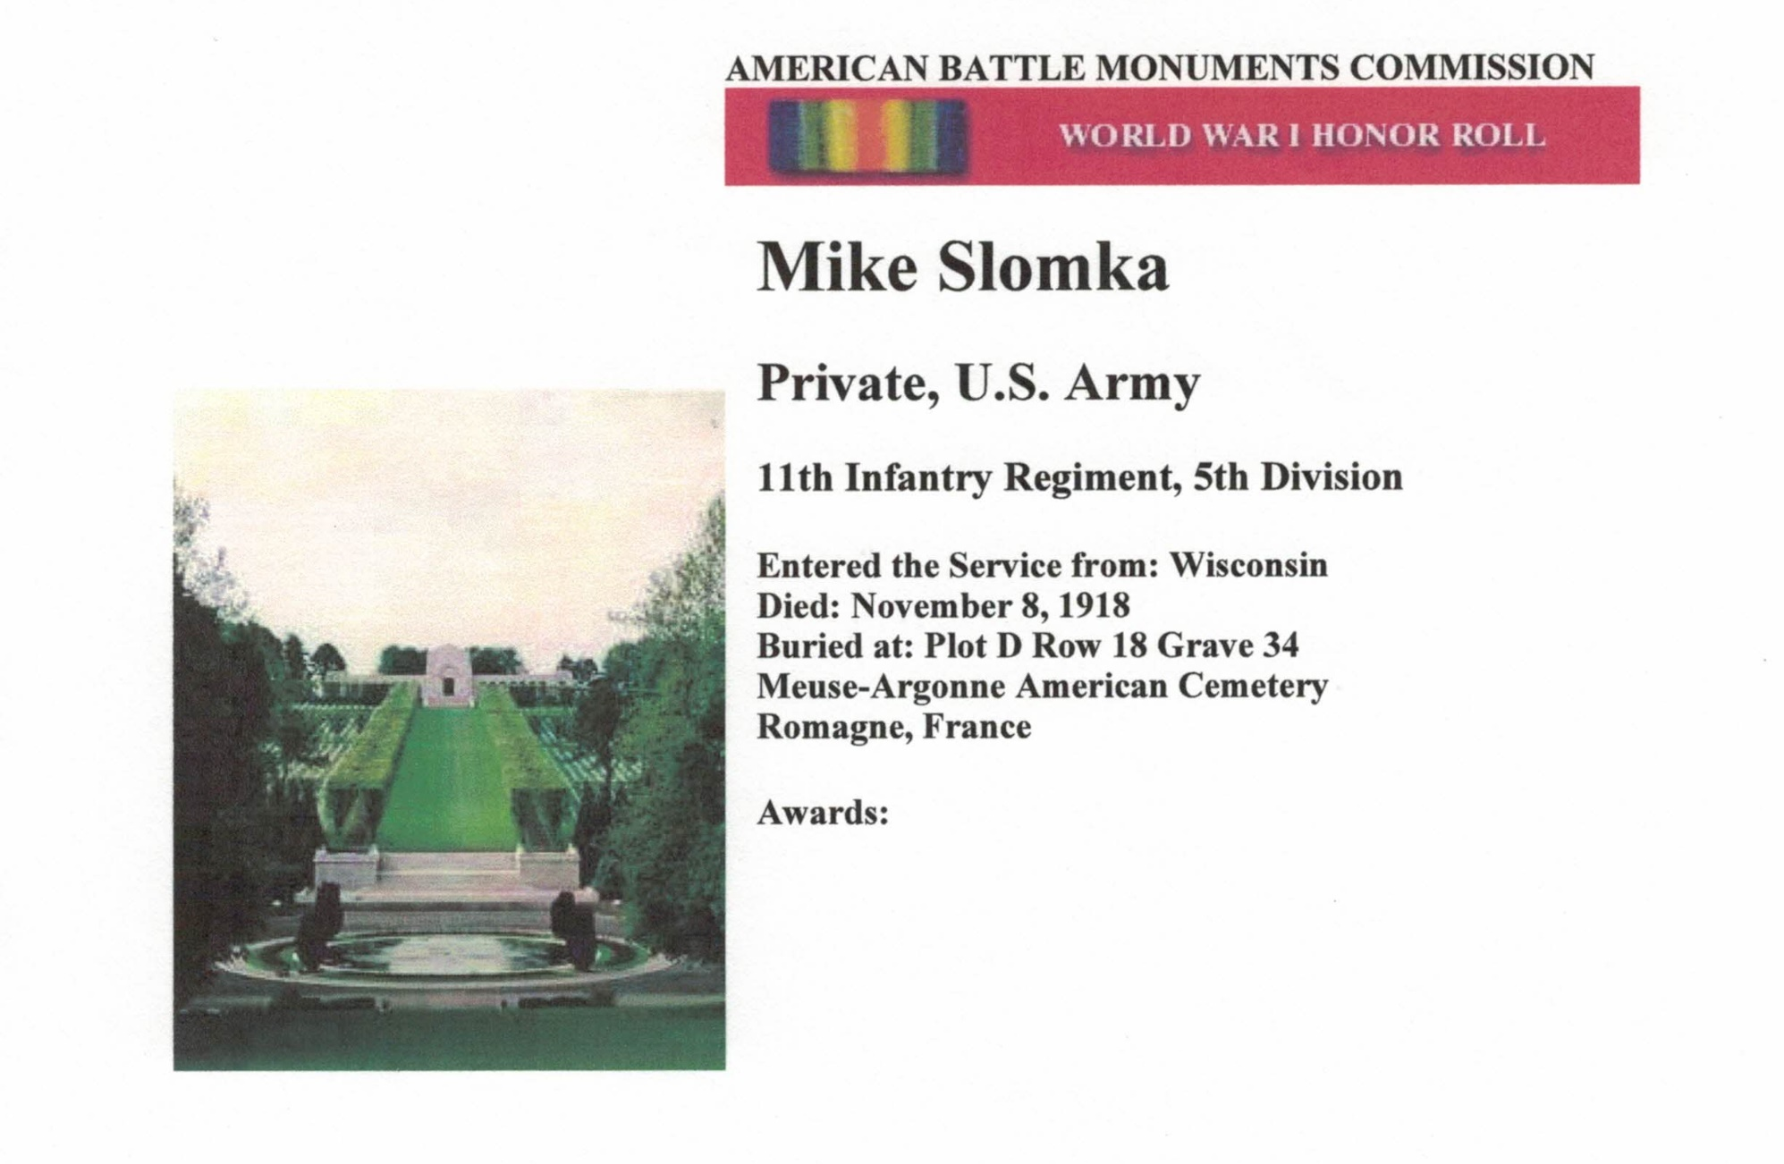
BURIED IN MEUSE-ARGONNE CEMETERY, FRANCE

Slide 32
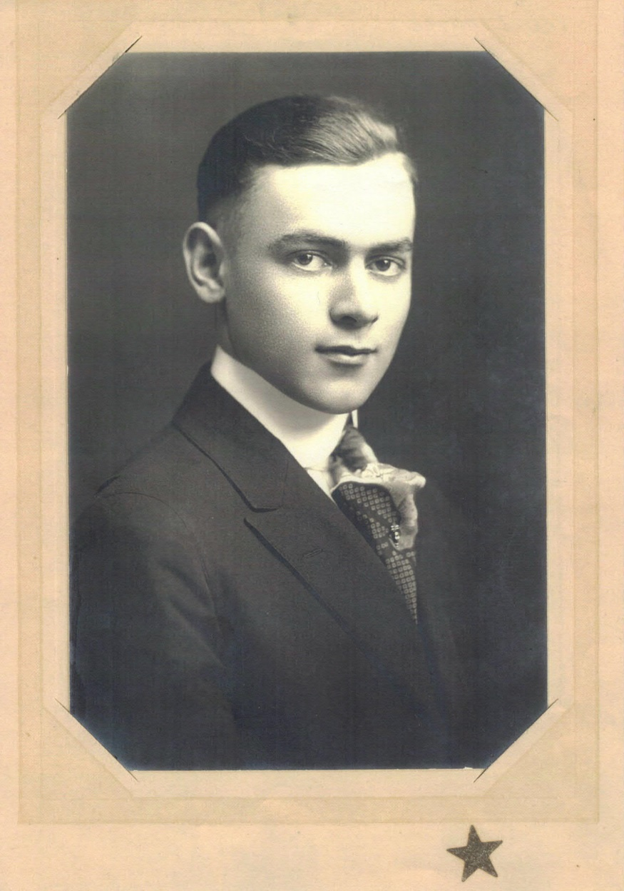
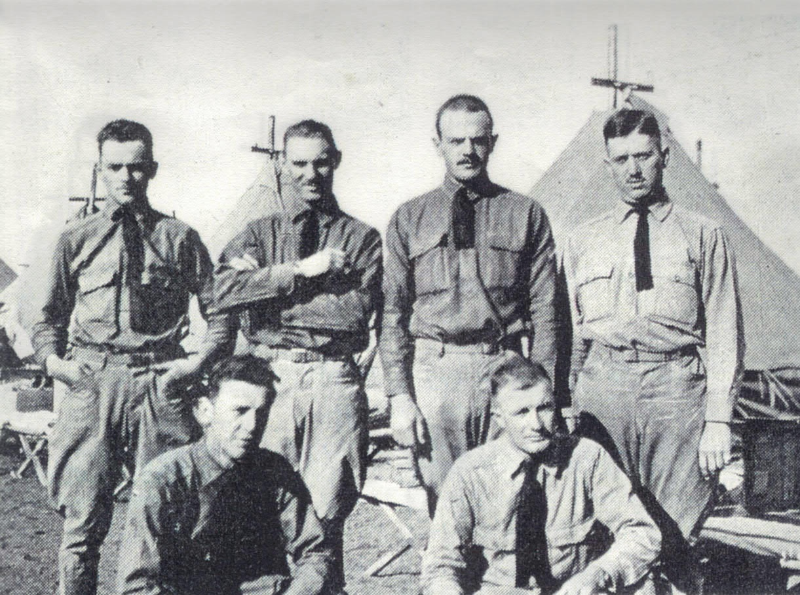
PRIVATE EVERHEART VAN EIMEREN

Slide 33
PRIVATE EVERHEART VAN EIMEREN
Born January 20, 1899 in Oak Creek.
Lived at 640 Hawthorne Avenue South Milwaukee.
Completed 2 years of High School and then apprenticed at Bucyrus.
Enlisted in the 1st Wisconsin Calvary on March 17, 1917.
Unit is converted to Battery C, 120th Filed Artillery, 32nd Division.
Killed along with Arthur Ryan and Alonzo Cudworth when French 75 artillery piece exploded on August 29, 1918. Age 19.
American Legion Post 27 was charted on August 30, 1919 in Van Eimeren’s name.
Body disinterred October 28, 1920 and shipped home. Received in South Milwaukee on December 31, 1920. Funeral Mass at St. Mary’s on January 1, 1921.
As with all local burials, Post 27, and local dignitaries attend the funeral in mass.

Slide 34
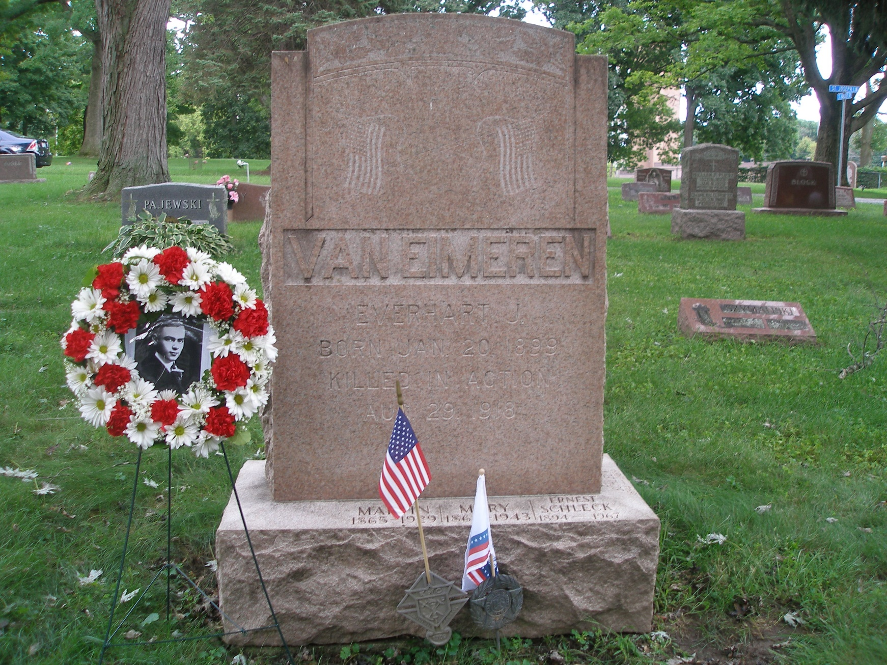
BURIED IN HOLY SEPULCHER CEMETERY CUDAHY

